Slide 1




DRAFT
Met Office
Security Issues Committee Chair
and Non-Executive Director
Candidate Pack
Closing Date: 02 September 2026
If you have any questions, require further information, or would like this candidate pack in an alternative format, please contact the Public Appointments team at Partnerships@dsit.gov.uk

Slide 2
Contents
3. Ministerial Foreword
4. About the Met Office
5. The Role and Requirements
9. Terms of Appointment
10. How to Apply
11. Assessment Panel, Process and Timeline
12. Equality, Diversity and Inclusion
13. Annex A: Met Office Purpose, Vision and Values
14. Annex B: Conflicts of Interest and Due Diligence
15. Annex C: The Seven Principles of Public Life
16: Annex D: Complaints Procedure

Slide 3
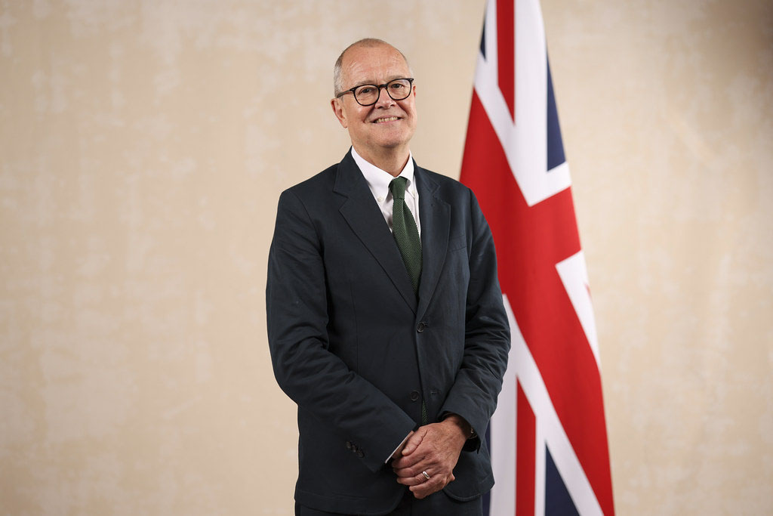
Ministerial Foreword
Dear Candidate,
Thank you for your interest in the role of Security Issues Committee Chair and Non-Executive Director.
The Met Office Board has a vital role in advising and supporting the Chief Executive and senior team to deliver the organisation’s strategic priorities and ensuring that resources are allocated effectively for their delivery. The Board approves the Met Office strategy and objectives, reviews management and performance and ensures that high standards of corporate governance are maintained.
As the UK’s national meteorological service, the Met Office operates across most aspects of national life whether that’s ensuring the safe operation of commercial aviation, enabling our armed forces to deploy around the globe to keeping British citizens safe in times of severe weather. Met Office activity spans across all sectors of the economy and the services it provides to the public, government and industry underpin national economic growth.
It is an exciting time to join the Met Office. In 2025, a new supercomputer facility in partnership with Microsoft successfully launched. This capability is a world first in scientific supercomputing delivered as a service and brings opportunity for new science to deliver clearer, more accurate and more intuitive forecasts. The Met Office is at the forefront of investigating the new AI capabilities and the optimum blend of techniques to deliver the best possible weather and climate predictions. In a radically changing world, the Met Office is better positioned than ever to translate world-leading weather and climate science and technology into actionable data and intelligence for the benefit of society, the economy and national security.
If you believe you have the experience and qualities we are seeking to help to lead and support this organisation, we very much look forward to hearing from you.
Lord Vallance
Minister of State for Science, Research, Innovation and Nuclear

Slide 4
About the Met Office
The Met Office is the UK’s national meteorological service, providing accurate, consistent and usable weather and climate data and intelligence. Its purpose is to help government, business and citizens make better decisions to stay safe and thrive. The Met Office provides data, expert advice, weather forecasts, extreme weather warnings, and climate science. Its products and services support daily life, safety and wellbeing, resilience of critical infrastructure and national security. Met Office customers and partners are in sectors from defence and transport, to UK government customers, energy and environment, citizen and media. In a radically changing world, there are increasing demands on the Met Office and our critical insights on the national and global stage.
The Met Office’s products and services are supported by cutting edge observation and data processing technology. Every day we turn vast amounts of data into actionable intelligence to enable better decision-making. Our outstanding team of experts make the Met Office a global authority on weather and climate science.
Since its foundation in 1854, the Met Office has pioneered the science of meteorology and its application. At a time of accelerating climate change, rapid technological innovation, geopolitical uncertainty, and increasing mis- and disinformation, the Met Office’s role in providing independent, impartial, trusted science and intelligence has never been more important.
Our vision is to deliver the most trusted weather and climate intelligence in a radically changing world.
Further information about the Met Office can be found at Annex A and here.

Slide 5
The Role - Security Issues Committee Chair
You will have both general responsibilities as a Non-Executive Director of the Met Office and specific responsibilities as Chair of the Security Issues Committee.
As a Non-Executive Director (NED) on the Met Office Board, you will play an important and demanding role using your knowledge, experience and network to provide independent advice, support and challenge to the Chief Executive and the executive team.
Your responsibilities as a NED will include:​
Promoting the long-term success of the Met Office for the benefit of all stakeholders.
Approving the strategy and corporate plan.
Promoting the desired values and culture of the organisation.
Ensuring adequate human and financial resources are available to deliver the strategy and plan.
Identifying and managing major risks and opportunities.
Approving the budget and key performance indicators, and monitoring performance against them.
Ensuring good governance and compliance with the framework agreement with the Met Office’s sponsoring department.
Working in partnership with the Chief Executive and other Board members as ambassadors and champions for the Met Office.

Slide 6
The Security Issues Committee (SIC) is ​an advisory committee of the Board that provides assurance and oversight to the Met Office Board, and advice to the Chief Executive and the senior team, on the Met Office’s security and resilience, and its work and governance arrangements relating to defence and national security.
Responsibilities of the SIC Chair:​
Providing advice, support and challenge on the Met Office’s strategic approach to security, resilience and the provision of services to the defence and national security community.
Advising the Board on the Met Office’s overall security posture and resilience.
Ensuring that the organisation maintains a proactive approach to the identification, mitigation and management of security-related risks.
Providing support and advice on the Met Office’s response to major incidents, including lessons learned.
Reviewing the business performance of the areas supporting national security, including the source and application of funding and the identification of future opportunities.
Reviewing the adequacy and effectiveness of the governance and internal control framework for work carried out in relation to defence and national security.
Reviewing and providing assurance that operational security arrangements are conducted in accordance with all relevant policies and regulations.
Supporting the Board and the senior team in the delivery of the Met Office’s Secure for the Future programme, including people, physical and cyber security arrangements.
Promoting a culture of safety and security across the Met Office.

Slide 7
Person Specification
The Secretary of State is seeking applications from individuals with senior professional, strategic and leadership experience in defence, security and technology. Candidates will be expected to obtain security clearance for this role. Applicants are invited from both the public and private sector. We are looking for candidates with the following skills:
Essential Criteria
Senior-level experience in defence and national security, including cyber security, resilience, and protective security, gained in a complex organisational or operational environment.
Strong understanding of technology and data-led organisations, including digital, IT, and emerging technologies, and the risks and opportunities they present.
Experience of chairing or leading high-level committees or boards dealing with security risk or other sensitive issues and handling sensitive, classified or confidential information appropriately with the confidence to provide robust challenge and independent judgement.
Proven ability to provide strategic advice and assurance on the identification, management and prioritisation of organisational risks, including those with national security, safety, or reputational implications.
Strong governance expertise, including oversight of risk management frameworks, escalation processes, and assurance mechanisms.
Excellent communication and interpersonal skills, with the ability to engage effectively with senior executives, board members, ministers, officials, and external stakeholders.

Slide 8
Person Specification
Desirable Criteria
Experience of leading or overseeing major transformation programmes, including organisational or digital change in large, complex organisations.
Commercial expertise, including go-to-market strategies for digital products or services.
Experience of working across or alongside government, the defence community, or national infrastructure bodies, with an understanding of public sector accountability and value for money.
A strong commitment to diversity and inclusion, with experience of championing inclusive leadership and constructive challenge at board or senior levels.
An understanding of, or strong interest in, science, research and innovation, and their role in supporting economic growth, resilience and national security.

Slide 9
Terms of Appointment
Appointment Term: An initial period of 3 years.
Remuneration: £20,000 per annum. Remuneration and expenses are taxable.
Time Commitment: 27 days per annum.
Location: Exeter.
Nature of Appointment: This is a Ministerial Appointment by the Secretary of State for Science, Innovation and Technology. The post holder would be an officeholder and not be an employee of the Department or the Met Office.
Availability: The successful candidate(s) will be encouraged to take up their appointment as soon as possible, following the successful completion of pre-appointment checks and security clearance at Developed Vetting (DV) level (if not already attained). Further details can be found here https://www.gov.uk/government/publications/united-kingdom-security-vetting-clearance-levels/national-security-vetting-clearance-levels.

Slide 10
How to Apply
Applications must be submitted by 23:55pm on 02 September 2026. Applications received after this date will not be considered.
To apply, you will need to create an account or sign in. Once you are logged into your account, click on ‘apply for this role’ and follow the on-screen instructions. To apply, all candidates are required to provide;
A Curriculum Vitae (CV)
A supporting statement
Equality information
Information relating to any outside interests or reputational issues
We will ask you to check and confirm your personal details to ensure your application is accurate.
You will also have the opportunity to make a reasonable adjustment request or apply under the disability confident scheme before you submit your application.

Slide 11
Assessment Panel, Process and Timeline
Date | Actions
02 September 2026 | Application Deadline
w/c 21 September 2026 | Shortlisting
w/c 19 October 2026 | Interviews
November/December 2026 | Successful candidate notified
November/December 2026 | Appointment announced
The above timeline is indicative and subject to change, and panel availability
Candidates will be sifted and interviewed by an Advisory Appointment Panel (AAP). Scoring at sift and interview is based on the criteria set out in the Person Specification. The AAP will determine which candidates are appointable.
The Secretary of State will appoint on merit from the list of appointable candidates.
The members of the AAP are:
Departmental Representative & Panel Chair: Lindsay Jamieson
Panel Member: Simon Thompson
Independent Panel Member: Wendy Barnes

Slide 12
Equality, Diversity and Inclusion
We are committed to increasing the diversity of our boards and bringing in talent, regardless of its origins. We encourage applications from all candidates, regardless of ethnicity, religion or belief, gender, sexual orientation, age, disability or gender identity. We particularly welcome applications from people with ethnicity, gender and disability characteristics currently underrepresented on our Boards.
Arrangements for candidates with a disability:
As a Disability Confident leader, we guarantee to interview anyone with a disability whose application meets the essential criteria for the post. More details on the criteria can be found in this pack. If you wish to apply through the Disability Confident scheme, you will need to tick the option on the Diversity Monitoring form that you will submit alongside your application.
Adjustments:
All candidates are entitled to request reasonable adjustments at any stage of the application process. If you would like to discuss adjustments prior to submitting your application, please contact partnerships@dsit.gov.uk

Slide 13












Annex A: Met Office Purpose, Vision and Priorities
OUR PURPOSE:
Helping you make better decisions to stay safe and thrive
PRIORITY
AREA.
Transforming to serve citizens, communities and businesses with trusted services which deliver growth and value.
OUR VISION:
Delivering the most trusted weather & climate intelligence in a radically changing world
Customer driven
PRIORITY
AREA.
PRIORITY
AREA.
Increasing value and driving growth by delivering the most accurate, consistent, and usable weather and climate data and intelligence.
Working with agility to balance innovation, risk and value for money.
Our people & values
OUR VITAL CORE
Agility
& innovation
Purposeful data
& intelligence
This is world-changing work
Our work is life-changing, often life-saving. It’s what we do, and the way we do it.
Each one of us takes personal responsibility for living the values which make the Met Office a great place to belong..

Slide 14
Annex B: Conflict of Interest and Due Diligence
Public Appointments require the highest standards of propriety, involving impartiality, integrity and objectivity, in relation to stewardship of public funds and the oversight and management of all related activities. This means that any private, voluntary, charitable or political interest that might be material and relevant to the work of the body concerned should be declared.
It is important that those appointed as members of public bodies maintain the confidence of Parliament and the public. If there are any issues in your personal or professional history that could, if you were appointed, be misconstrued, cause embarrassment, or cause public confidence in the appointment to be jeopardised, it is important that you bring them to the attention of the Assessment Panel and provide details of the issue(s) in your application. In considering whether you wish to declare any issues, you should also reflect on any public statements you have made, including through social media. The Panel may explore issues with you before they make a recommendation on the appointment.
As part of our due diligence checks we will consider anything in the public domain related to your conduct or professional capacity. This will include us undertaking searches of previous public statements and social media, blogs or any other publicly available information. This information may be made available to the Panel, and they may wish to explore issues with you, should you be invited to interview.
If you have any queries or would like to discuss further, please contact partnerships@dsit.gov.uk.

Slide 15
Annex C: The Seven Principles of Public Life
In 1995 the Committee on Standards in Public Life defined seven principles for public life. All candidates for are expected to demonstrate a commitment to, and an understanding of, the value and importance of the principles of public service which are:
Selflessness
Integrity
Objectivity
Accountability
Openness
Honesty
Leadership
Further information on the principles of public life can be found here.

Slide 16
Annex D: Complaints Procedure
If you feel you have reason to complain you should direct your concerns in the first instance to the Public Appointments team at partnerships@dsit.gov.uk who will make every effort to deal with these and respond to you within 48 hours.

