Slide 1


Information Commission
Chair
Candidate Pack
Closing Date: 19 August 2026
If you have any questions, require further information, or would like this candidate pack in an alternative format, please contact the Public Appointments team at partnerships@dsit.gov.uk

Slide 2

Contents
03 Ministerial Foreword
04 About the Information Commission
05 Appointment Description
06 Person Specification – Essential criteria
09 How to apply
10 Assessment Panel and Timeline
11 Equality and Diversity
12 Eligibility
13 Annex A Conflicts of Interest and Due Diligence
14 Annex B The seven principles underpinning public life
15 Annex C DSIT Complaints Procedure
07 Person Specification – Desirable criteria
08 Terms of Appointment

Slide 3
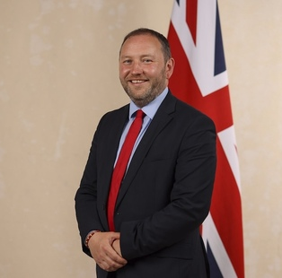
Dear Candidate,
Thank you for your interest in becoming Chair of the Information Commission.
The Information Commissioner’s Office (ICO) is undergoing an exciting transformation as it transitions to a new governance model. The Information Commission has been established by the Data (Use and Access) Act 2025 and, later this year, will take over the ICO’s functions to become the new independent UK data protection regulator.
Like its predecessor, the Information Commission will sit at the heart of the UK’s data and digital landscape and will play a critical role in maintaining public trust, upholding high data standards and ensuring personal data is used responsibly and innovatively to deliver economic and social benefits. The new board structure of the Commission will bring together a diverse range of skills, experience and perspectives to steer the regulator through a fast-changing landscape, ensuring it can successfully deliver on its ambitious agenda.
As Chair, you will lead the Information Commission through a period of technological development, increasingly complex data-driven services, and evolving expectations around transparency and accountability. You will help the Commission navigate this environment and shape the strategic direction of the organisation, ensuring that it regulates with rigour, transparency, and in a proportionate manner.
You will work closely with counterparts across the regulatory landscape to promote coherence and alignment, particularly on issues such as AI governance, protecting children’s privacy, improving cross sector data use and information resilience, and digital innovation. Your leadership will play an important part in maintaining the UK’s reputation for high standards in data protection while fostering an environment where responsible innovation can thrive.
We are looking for an individual with exceptional strategic vision, strong judgement, and the ability to collaborate effectively across industry, government and civil society. This role requires a deep commitment to public service and to protecting the rights and interests of people across the UK.
If you believe you have the skills, experience and ambition to lead the Information Commission through this important next chapter, we very much look forward to hearing from you.
The Rt Hon. Ian Murray MP
Minister for Digital Government and Data
Ministerial Foreword
The Rt Hon. Ian Murray MP
Minister for Digital Government and Data

Slide 4
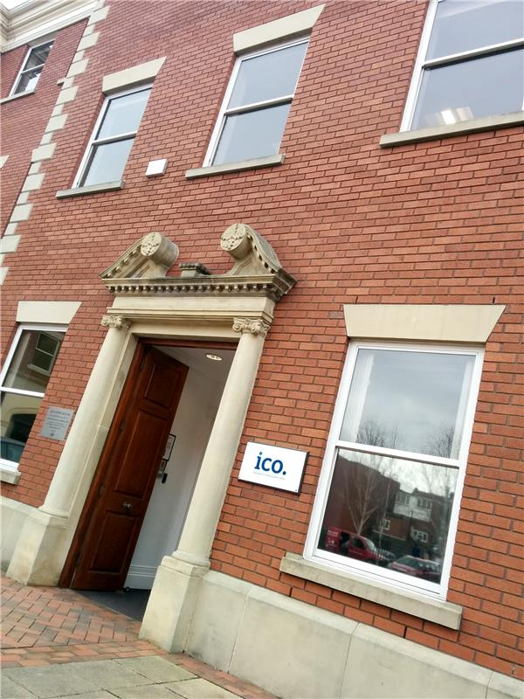
About the Information Commission
The Information Commission was established by the Data (Use and Access) Act 2025 to succeed the Information Commissioner’s Office (ICO) as the UK’s independent supervisory authority with responsibility for monitoring and enforcing the application of data protection legislation in the UK.
Later this year, the Information Commission will be taking over all the functions and responsibilities of the ICO. In doing so, the Commission will be responsible for the regulation of personal data protection and privacy and electronic communications legislation and will also be empowered to take regulatory action under other legislation, including the Freedom of Information Act 2000 and the Network and Information System Regulations 2018.
In line with these responsibilities, the Commission will inherit a range of important public-facing functions. These include providing advice to individuals about their information rights and obligations, handling complaints, and taking proportionate action to improve organisations’ information rights practices, enforcing the law where necessary. The Commission will also play a significant role internationally in upholding and developing high standards of data protection.

Slide 5

Appointment Description
The Chair will be expected to:
Provide leadership, oversight and strategic direction to the Information Commission, ensuring it delivers its statutory functions effectively, independently and in the public interest.
Bring together the diverse perspectives and experiences of Board members to guide discussion, establish effective ways of working and shape a professional and accountable Board culture. Oversee the performance of the Board and its members.
Provide challenge and support to help the Information Commission deliver its objectives, ensuring sound financial management, good corporate governance and regular performance oversight.
Ensure the Information Commission has the skills and capability required to respond to current and future regulatory challenges in a rapidly evolving data and digital landscape. Promote diversity, inclusion and fair treatment across its workforce.
Consider the government’s wider strategic priorities, including promoting economic growth and showing commitment to proportionate, risk-based regulation that minimises burdens whilst protecting individual rights.
Represent the Information Commission with authority and credibility to the public, industry, civil society, Ministers, Parliament, international partners and the public.

Slide 6
Person Specification
Essential Criteria
A track record of successful strategic leadership to set direction on complex, technical or rapidly evolving issues and to drive forward priorities of the organisation. (Lead criteria)
Extensive board-level experience in high-profile organisations, with a proven ability to lead diverse boards, foster constructive challenge, build consensus and ensure effective governance and decision-making.
A proven ability to scrutinise and challenge the running of an organisation, including its financial, performance and risk management.
Excellent interpersonal and communication skills with the ability to represent a high-profile organisation with authority to a wide range of stakeholders.
Demonstrable ability to work closely with the executive team and other internal and external stakeholders and build trusted relationships.
Please note: If we receive a high volume of applications, the panel will assess candidates against the lead criteria only as indicated above.

Slide 7
Person Specification
Desirable Criteria
Senior experience working or consulting in the regulatory landscape either domestically or internationally, preferably in areas relevant to the Information Commission’s remit.
An understanding of the Information Commission’s work, priorities and challenges and the context within which it operates.

Slide 8
Terms of Appointment
Appointment Term: An initial period of 4 years.
Remuneration: £120,000 per annum.
Time Commitment: The Chair will be expected to commit to an average of 3 days per week (156 days per year).
Location: Hybrid. The Information Commission headquarters will be located in Manchester, UK.
Attendance: The Chair will be expected to attend board meetings and similar engagement at the Information Commission’s offices in Manchester and London.
Nature of Appointment: This appointment is made by His Majesty the King on the recommendation of the Secretary of State for Science, Innovation and Technology. The post holder will be an officeholder and not an employee of the Department or the public body.
Availability: Successful candidates will be encouraged to take up their appointment as soon as possible, following the successful completion of pre-appointment checks and security clearance at Baseline Personnel Security Standard (BPSS) level. Further details can be found here https://www.gov.uk/government/publications/united-kingdom-security-vetting-clearance-levels/national-security-vetting-clearance-levels.

Slide 9
How to apply
Applications must be submitted by 11:55pm on 19/08/2026. Applications received after this date will not be considered.​
​
To apply, you will need to create an account or sign in via the Public Appointments website.
A CV of maximum two pages and an accompanying covering letter setting out suitability for the role of no more than two pages. Any applications that exceed the stated page limit will not be considered.
The appointment will be made in accordance with the Cabinet Office’s Governance Code on Public Appointments. The appointment process is regulated by the Commissioner for Public Appointments.
A good application will set out specific information about how you meet the person specification for this appointment. Think about your knowledge, skills, experience and personal attributes, and take full advantage of the space available. Provide practical evidence that best demonstrates how you meet the essential and any desirable criteria.​
​
We will ask you to check and confirm your personal details to ensure your application is accurate.​
​
You will also have the opportunity to make a reasonable adjustment request or apply under the disability confident scheme before you submit your application.
The Advisory Assessment Panel reserves the right to only consider applications that contain all of the elements listed above, and that arrive before the published deadline for applications.
The preferred candidate for the role of Chair will be required to appear before a Parliamentary Select Committee for a pre-appointment hearing.
For queries about your application or the recruitment process, please email partnerships@dsit.gov.uk

Slide 10
Assessment panel and Indicative Timeline
The members of the Advisory Assessment Panel are:
Panel Chair and DSIT Representative:
Emily Middleton, Director General for Digital Transformation
Senior Independent Panel Member:
Dame Colette Bowe, Previous Ofcom Chair 2009-2014
Independent Panel Member:
Professor Graeme Reid, Professor of Science and Research Policy, University College London
The timelines for this campaign is indicative and subject to change. Please check the advert for any updates. Interview dates will be confirmed closer to the time. | Please note, all dates are indicative and subject to change)
Advert Closes | 19 August 2026
Panel Sift | 22 September 2026
Panel Interview | w/c 2 November 2026 (TBC)
Candidates notified of final outcome | December 2026 (TBC)
Appointment confirmed | March 2027 (TBC)

Slide 11
Equality, Diversity and Inclusion
We encourage applications from talented individuals from all backgrounds and across the whole of the United Kingdom.
We collect data about applicants’ characteristics and backgrounds, including information about people’s educational and professional backgrounds, so that we can make sure we are attracting a broad range of people to the role and that our selection processes are fair for everyone. Without this information, it makes it difficult to see if our outreach is working, if the application process is having an unfair impact on certain groups and whether changes are making a positive difference.
When you submit your application, your responses are collected by the Cabinet Office and the government department(s) managing your application. The data is used to produce management information about the diversity of applicants. You can select “prefer not to say” to any question you do not wish to answer. The information you provide will not be seen by the Advisory Assessment Panel who review applications against the advertised criteria and conduct interviews.
Arrangements for candidates with a disability:
As a Disability Confident leader, we guarantee to interview anyone with a disability whose application meets the essential criteria for the post. More details on the criteria can be found in this pack. If you wish to apply through the Disability Confident scheme, you will need to tick the option on the Diversity Monitoring form that you will submit alongside your application.
Adjustments:
All candidates are entitled to request reasonable adjustments at any stage of the application process. If you would like to discuss adjustments prior to submitting your application, please contact partnerships@dsit.gov.uk.
For queries about your application or the recruitment process, please email the BEIS Appointments Team at publicappointments@beis.gov.uk

Slide 12
Eligibility
In general, you should have the right to work in the UK to be eligible to apply for a public appointment. There are a small number of specialist roles that are not open to non-British citizens. Any nationality requirements will be specified in the vacancy details. The Government expects all holders of public office to work to the highest personal and professional standards.
You cannot be considered for a public appointment if:
* you are disqualified from acting as a company director (under the Company Directors Disqualification Act 1986);
* have an unspent conviction on your criminal record;
* your estate has been sequestrated in Scotland or you enter into a debt arrangement programme under Part 1 of the Debt Arrangement and Attachment (Scotland) Act 2002 (asp 17) as the debtor or have, under Scots law, granted a trust deed for creditors.
When you apply, you should declare if:
* you are, or have been, bankrupt or you have made an arrangement with a creditor at any point, including the dates of this.
* you are subject to a current police investigation.
You must inform the sponsor department if, during the application process, your circumstances change in respect of any of the above points.
When you apply you should also declare any relevant interests, highlighting any that you think may call into question your ability to properly discharge the responsibilities of the role you are applying for. You should also declare any other matters which may mean you may not be able to meet the requirements of the [1] Code of Conduct of Board Members (see Outside interests and reputational issues section below).
For queries about your application or the recruitment process, please email the BEIS Appointments Team at publicappointments@beis.gov.uk
For queries about your application or the recruitment process, please email partnerships@dsit.gov.uk

Slide 13
Annex A
Conflicts of interest and due diligence
Public Appointments require the highest standards of propriety, involving impartiality, integrity and objectivity, in relation to stewardship of public funds and the oversight and management of all related activities. This means that any private, voluntary, charitable or political interest that might be material and relevant to the work of the body concerned should be declared.
It is important that those appointed as members of public bodies maintain the confidence of Parliament and the public. If there are any issues in your personal or professional history that could, if you were appointed, be misconstrued, cause embarrassment, or cause public confidence in the appointment to be jeopardised, it is important that you bring them to the attention of the Assessment Panel and provide details of the issue(s) in your application. In considering whether you wish to declare any issues, you should also reflect on any public statements you have made, including through social media. The Panel may explore issues with you before they make a recommendation on the appointment.
As part of our due diligence checks we will consider anything in the public domain related to your conduct or professional capacity. This will include us undertaking searches of previous public statements and social media, blogs or any other publicly available information. This information may be made available to the Panel and they may wish to explore issues with you, should you be invited to interview.
If you have any queries or would like to discuss further, please contact the DSIT Partnerships Team at partnerships@dsit.gov.uk

Slide 14
Annex B
The Seven Principles underpinning Public Life
In 1995 the Committee on Standards in Public Life defined seven principles for public life. All candidates for are expected to demonstrate a commitment to, and an understanding of, the value and importance of the principles of public service which are:
Selflessness
Integrity
Objectivity
Accountability
Openness
Honesty
Leadership
Further information on the principles of public life can be found here.

Slide 15
Annex C
DSIT Complaints procedure
If you feel you have reason to complain you should direct your concerns in the first instance to the DSIT Public Appointments team (partnerships@dsit.gov.uk) who will make every effort to deal with these and respond to you within 48 hours.
If your complaint is not dealt with satisfactorily, you can find information about the steps you can take under DSIT Complaints Procedure here.
The Commissioner for Public Appointments is the independent regulator of public appointments. The Commissioner’s primary role is to provide independent assurance that public appointments are made in accordance with the Governance Code on Public Appointments. The Commissioner also investigates complaints and may conduct an inquiry into the policies and practices followed in relation to appointments processes which he regulates. The Commissioner will not investigate complaints relating to non-selection unless it appears that the appointments process has breached the Governance Code on Public Appointments.
You can contact the Commissioner by email at publicappointments@csc.gov.uk or by post, as follows:
The Commissioner for Public Appointments
Room G/8, 1 Horse Guards Road
London, SW1A 2HQ
Further information on the role of the Commissioner or the appointments process is available at: publicappointmentscommissioner.independent.gov.uk.

