Slide 1




Council for Science and Technology
Co-chair
Candidate Pack
Closing Date: 12:00 01 July 2026 – EXTENDED DEADLINE
If you have any questions, require further information, or would like this candidate pack in an alternative format, please contact the Public Appointments team at partnerships@dsit.gov.uk and CST secretariat at cstsecretariat@go-science.gov.uk

Slide 2
Contents
Message to Candidates from Dame Angela McLean
About the Council for Science & Technology (CST)
The Role
Person Specification
Essential Criteria
Desirable Criteria
Terms of Appointment
How to Apply
Assessment Panel, Process and Timeline
Equality, Diversity and Inclusion
Annex A: Conflicts of Interest and Due Diligence
Annex B: The Seven Principles of Public Life
Annex C: Complaints Procedure

Slide 3
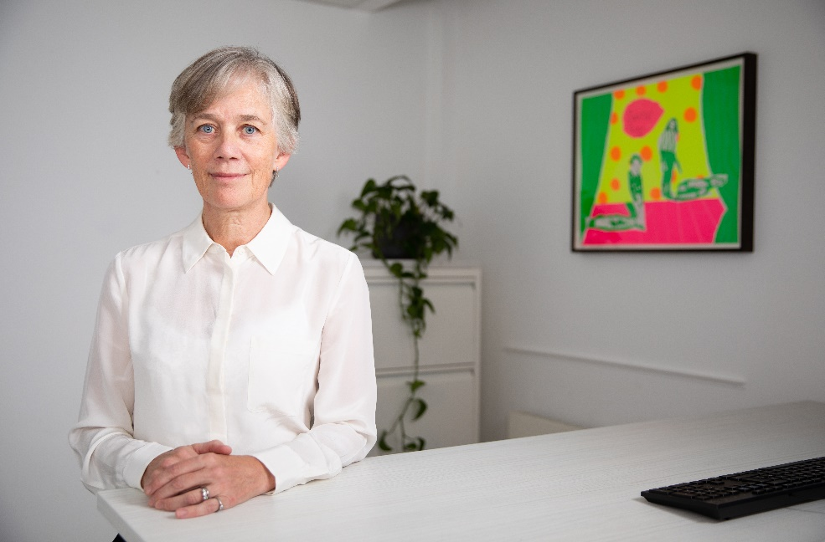
Message to Candidates from Dame Angela McLean
The UK government has set out a clear ambition to accelerate growth across the UK through world-class science and research and the safe development and deployment of new technologies. Putting excellent scientific advice at the heart of decision making is key to the delivery of this government’s priorities.
The Council for Science and Technology provides independent advice directly to the Prime Minister and Cabinet Ministers on national priorities, from primary prevention in healthcare to the role of science and technology in addressing geographical inequalities across the UK.
We are looking for an independent co-chair who has extensive experience as a leader in their field and wants to make an impact on the UK’s science and technology landscape. The independent co-chair will work in partnership with myself to provide strategic leadership to the council, shaped by their experience across academia, industry, and government.
This is an opportunity to bring your valuable insight to the council, shaping and leading the work that it does, delivering through distinguished members to develop independent advice that will help government deliver growth and improved outcomes for society.
Professor Dame Angela McLean, Government Chief Scientific Adviser

Slide 4
About the Council for Science & Technology (CST)
CST is the government’s highest-level advisory body on science and technology delivering advice directly to the Prime Minister and Cabinet on science, engineering, technology and innovation policy issues across government. It is jointly chaired by an independent co-chair and the Government Chief Scientific Adviser, Dame Angela McLean.
CST provides impartial advice to the Prime Minister and Cabinet on:
what the government’s high-level priorities for science and technology should be to support the delivery of the government’s priorities;
emerging and long-term scientific and technological developments, including opportunities and risks relating to:
  science and research capability
  innovation and economic growth
  health and quality of life within the UK
  sustainable development and resilience
other matters requested by the Prime Minister, Ministers, or considered important by the council.
Further information about the Council for Science and Technology can be found here.

Slide 5
The Role
The CST independent co-chair shares responsibility for chairing the council with the Government Chief Scientific Adviser (GCSA).
The independent co-chair is responsible for:
deciding the course of the CST work programme and agreeing project leads;
working and liaising with the GCSA, ministers and officials to inform CST advice and delivery of recommendations;
being the outward spokesperson and advocate for CST;
agreeing agendas for meetings with the GCSA;
chairing the meetings when agenda items might conflict with the GCSA’s role; and
facilitating discussion among members to help reach a consensus on advice to government.
The independent co-chair will be supported by the CST Secretariat based in the Government Office for Science.

Slide 6
Person Specification
The government is seeking applications from senior figures with a science, technology, engineering, or innovation background. Individual disciplines are, however, less important than the ability to provide a well-grounded ‘big picture’ perspective on a wide variety of STEM policy issues.
The independent co-chair of CST is appointed as an individual. The independent co-chair of CST is not appointed as a representative of their profession, employer, or interest group, and they have a duty to act in the public interest. The independent co-chair must at all times observe the highest standards of impartiality, integrity, and objectivity in relation to the advice they provide.

Slide 7
Essential Criteria
To be successful at interview you will need to demonstrate the following essential skills:
Experience: a strong track record in senior leadership roles in academia, commerce, industry, or public service, usually at the level of chief executive, vice chancellor, or an equivalent senior leadership role, with the ability to set strategic vision and drive forward priorities of the Council for Science and Technology.
Influence: Proven ability to proactively build and maintain high-trust relationships and networks at the most senior levels and across organisational siloes. Skilled at synthesising diverse perspectives, creating consensus and leading the development of timely, independent, evidence-based, and actionable advice. Tenacity to follow up on the advice provided and support implementation.
Collaboration: Skilled at convening and chairing. Able to demonstrate the independence and authority necessary to guide this council of experts. Able to foster a diverse and inclusive culture to create a collaborative advisory environment, drawing in a wide range of inputs and experience.
Communication: Outstanding communication skills including the ability and willingness to act as the outward spokesperson for CST, to engage with relevant organisations that could inform CST’s work and to be actively involved in the promotion of CST’s profile.

Slide 8
Desirable Criteria
Cross-sector experience: Previous experience of having worked across academic, industry practitioner, investor, and government communities.
Judgement: Experience demonstrating personal and political sensitivity and judgement in the consideration and handling of issues with colleagues, government, and external parties.

Slide 9
Terms of Appointment
Appointment Term: An initial period of 3 years.
Remuneration: The co-chair is not remunerated except for reasonable travel and subsistence costs related to council business.
Time Commitment: Three to four days per month
Location: The council generally meets four times a year in Central London, in addition to ad hoc meetings with Ministers and senior officials. Other work is done by correspondence or virtual meetings.
Nature of Appointment: This is a Ministerial Appointment by the Secretary of State for Science, Innovation and Technology. The post holder would be an officeholder and not be an employee of the Department or the Council for Science and Technology.
Availability: The successful candidate will be expected to begin their term on 1 April 2027 following the successful completion of pre-appointment checks and security clearance at Baseline Personnel Security Standard (BPSS) level. Further details can be found here https://www.gov.uk/government/publications/united-kingdom-security-vetting-clearance-levels/national-security-vetting-clearance-levels.

Slide 10
How to Apply
Applications must be submitted by 12:00 on 01/07/2026. Applications received after this date and time will not be considered.
To apply you will need to create an account or sign in via the Public Appointments website. Once you are logged into your account, click on ‘apply for this role’ and follow the on-screen instructions. To apply, all candidates are required to provide;
A two-page curriculum vitae (CV)
A two-page supporting statement
Equality information
Information relating to any outside interests or reputational issues
In your supporting statement you should:
Set out specific information about how you meet the person specification for this appointment. Think about your knowledge, skills, experience and personal attributes, and take full advantage of the space available. Provide practical evidence that best demonstrates how you meet the essential and any desirable criteria.
Briefly outline what you wish to achieve as the co-chair of CST.
We will ask you to check and confirm your personal details to ensure your application is accurate.
You will also have the opportunity to make a reasonable adjustment request or apply under the disability confident scheme before you submit your application.

Slide 11
Assessment Panel, Process and Timeline
Candidates will be sifted and interviewed by an Advisory Appointment Panel (AAP). Scoring at sift and interview is based on the criteria set out in the Person Specification. The AAP will determine which candidates are appointable.
The Secretary of State will appoint on merit from the list of appointable candidates.
The members of the AAP are:
Panel Chair - Dame Angela McLean, Government Chief Scientific Adviser and Co-chair of CST
CST Representative – Sir John Lazar, President of President of Royal Academy of Engineering
Independent Panel Member – Professor Dame Nancy Rothwell
(full details of the assessment panel will be provided if shortlisted).
Interviews will be held in person in London.
Date | Actions
12:00 1 July | Application Deadline
Week commencing 13 July | Shortlisting
Week commencing 14 September | Interviews
Week commencing 26 October | Successful candidate notified
Week commencing 7 December | Appointment announced
The above timeline is indicative and subject to change.

Slide 12
Equality, Diversity and Inclusion
We are committed to increasing the diversity of our boards and bringing in talent, regardless of its origins. We encourage applications from all candidates, regardless of ethnicity, religion or belief, gender, sexual orientation, age, disability or gender identity. We particularly welcome applications from people with ethnicity, gender and disability characteristics currently underrepresented on our Boards.
Arrangements for candidates with a disability:
As a Disability Confident leader, we guarantee to interview anyone with a disability whose application meets the essential criteria for the post. More details on the criteria can be found in this pack. If you wish to apply through the Disability Confident scheme, you will need to tick the option on the Diversity Monitoring form that you will submit alongside your application.
Adjustments:
All candidates are entitled to request reasonable adjustments at any stage of the application process. If you would like to discuss adjustments prior to submitting your application, please contact partnerships@dsit.gov.uk.

Slide 13
Annex A: Conflict of Interest and Due Diligence
Public Appointments require the highest standards of propriety, involving impartiality, integrity and objectivity, in relation to stewardship of public funds and the oversight and management of all related activities. This means that any private, voluntary, charitable or political interest that might be material and relevant to the work of the body concerned should be declared.
It is important that those appointed as members of public bodies maintain the confidence of Parliament and the public. If there are any issues in your personal or professional history that could, if you were appointed, be misconstrued, cause embarrassment, or cause public confidence in the appointment to be jeopardised, it is important that you bring them to the attention of the Assessment Panel and provide details of the issue(s) in your application. In considering whether you wish to declare any issues, you should also reflect on any public statements you have made, including through social media. The Panel may explore issues with you before they make a recommendation on the appointment.
As part of our due diligence checks we will consider anything in the public domain related to your conduct or professional capacity. This will include us undertaking searches of previous public statements and social media, blogs or any other publicly available information. This information may be made available to the Panel, and they may wish to explore issues with you, should you be invited to interview.
If you have any queries or would like to discuss further, please contact partnerships@dsit.gov.uk

Slide 14
Annex B: The Seven Principles of Public Life
In 1995 the Committee on Standards in Public Life defined seven principles for public life. All candidates for are expected to demonstrate a commitment to, and an understanding of, the value and importance of the principles of public service which are:
Selflessness
Integrity
Objectivity
Accountability
Openness
Honesty
Leadership
Further information on the principles of public life can be found here.

Slide 15
Annex C: Complaints Procedure
If you feel you have reason to complain you should direct your concerns in the first instance to the Public Appointments team at partnerships@dsit.gov.uk who will make every effort to deal with these and respond to you within 48 hours.

