Slide 1


Ebbsfleet Development Corporation – 1x ARAC Chair and 1x Non-Executive Director
Information Pack for Candidates
Closing Date: 16:00 on 5 January 2026

Slide 2
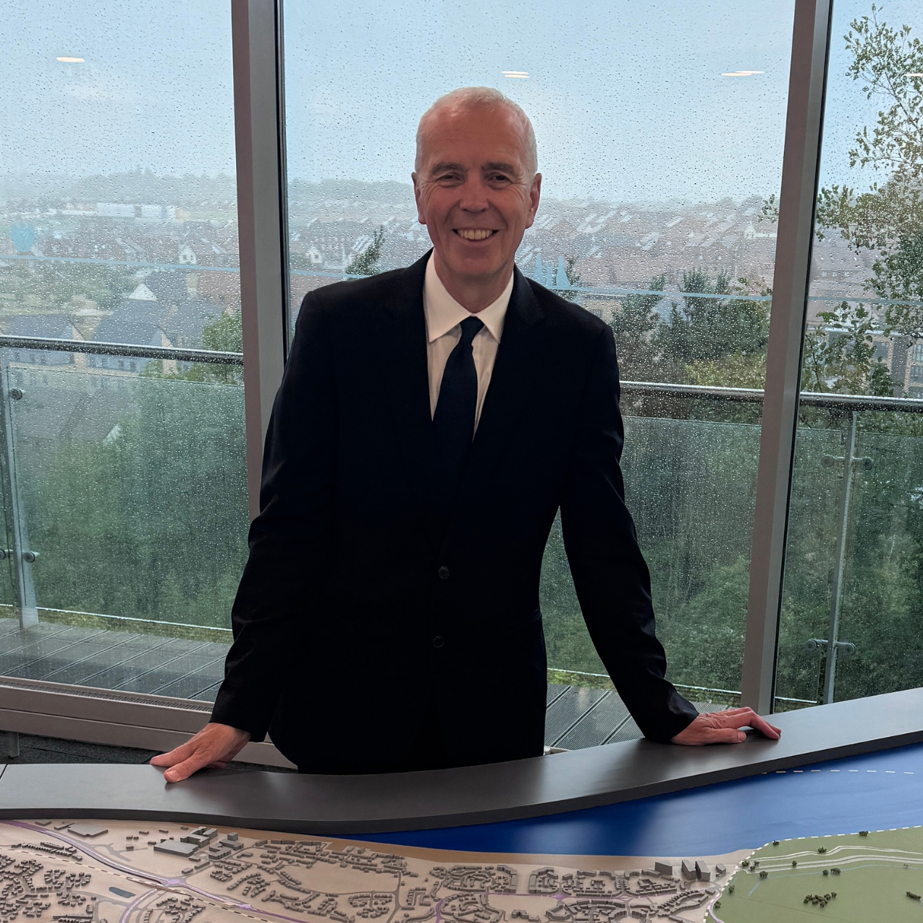
Introduction from the Chief Executive
Ebbsfleet Development Corporation (EDC) was established in 2015 to deliver a new community of up to 15,000 homes, as well as new schools, parks, health facilities and a new civic and commercial centre. EDC is the planning authority for the development area with Development Management powers having transferred from Dartford Borough Council and Gravesham Borough Council.
EDC is an inclusive organisation, and we actively promote equality of opportunity for everybody who has dealings with us.
I would like to encourage you to consider applying to join EDC’s Board to help us to realise the exciting opportunities and meet the challenges of delivering a new community, based on garden city principles, across 2,500 acres of brownfield land on the Kent Thames riverside.
This is a fascinating role and offers a rare opportunity to help shape a whole new place. Ebbsfleet is an area with incredible economic potential, and its development will bring new investment for the benefit of the new and existing local communities.
We hope to receive applications from a wide range of individuals and would particularly welcome candidates that would broaden the diversity of the Board, including from an ethnic minority background.
Dr David Prout​
​
Chair of the EDC Board

Slide 3
About EDC
The Secretary of State for the Ministry of Housing, Communities and Local Government (MHCLG) is seeking to appoint two Non- Executive Board Members to the Ebbsfleet Development Corporation, which plays an essential role in supporting the government’s ambition to build 1.5 million homes in this parliament. We will be looking to appoint one of the successful candidates to the role of Audit and Risk Assurance Committee (ARAC) Chair.
Ebbsfleet Development Corporation was established in 2015 as a non-departmental public body responsible for the regeneration of the new garden city and the delivery of up to 15,000 new homes as well as new schools, parks, health facilities and a new commercial centre. EDC is the planning authority for the development area with planning powers transferred from Dartford Borough Council and Gravesham Borough Council.
Ebbsfleet Garden City is being created across 2,500 acres of brownfield land on the Kent Thames riverside. There are now 5,000 completed homes at Ebbsfleet, three primary schools, with two more under construction, and in September the first pupils will start at the new Alkerden education campus before a full opening in 2026.
The new board members would be joining a high performing organisation, which leveraged c.£507m of private sector investment into the area in the most recent financial year and which has succeeded in the delivery of core infrastructure – including a new transport infrastructure, increased electrical capacity through the provision of a whole new grid system under an innovative agreement with UK Power Networks, and a number of parks and open spaces.
Ebbsfleet Garden City consistently scores above average resident satisfaction results, with 84% satisfied with their local area and 90% with their homes in the most recent survey. This impressive community engagement is a source of pride for the development corporation and any new board member will be expected to ensure that this strong community engagement continues.
Information about the Corporation, Board members and more can be found on the EDC website.

Slide 4
About the roles
Board members have collective corporate responsibility for ensuring that the Corporation discharges its functions effectively and efficiently; that it fulfils the overall aims, objectives and priorities set out in its corporate plan; and that it complies with all statutory or administrative requirements relating to the use of public funds.
Board members are responsible for:
  Setting the strategic direction for the Corporation;
  Overseeing and driving the successful delivery of the Corporation’s remit;
  Holding the Corporation’s management to account for the effective use of public funds and driving value for money by receiving and reviewing regular financial data and other information concerning the management of the Corporation;
  Ensuring that the Corporation’s affairs are conducted with probity and that high standards of corporate governance are observed at all times – abiding by the framework agreement with MHCLG and any subsidiary documents thereof;
  Ensuring that the Board operates within the limits of its statutory authority and in accordance with the authority delegated from its sponsoring Department and with guidance issued by it;
  Complying at all times with the rules relating to the use of public funds and to conflicts of interest; and
  Acting in accordance with the Seven Principles of Public Life (the “Nolan Principles”).

Slide 5
Selection Criteria
All candidates must demonstrate, in their CV and supporting letter, how they meet the selection criteria for the roles, through their knowledge, skills and experience.
Essential Criteria
Desirable Criteria
A strong track record of making effective decisions on significant issues within the private, public or voluntary sectors;
Excellent communication and stakeholder engagement skills with the ability to command the respect of, and to challenge, fellow Board members, staff and senior stakeholders in both the public and private sectors.
Strong commercial and financial acumen.
Strong analytical skills with an ability to get to grips with complex issues.
FOR ARAC CHAIR: Experience of, or demonstrable understanding of, finance, audit, risk, governance and assurance, preferably in the public sector.
FOR NED: A background or experience in commercial or mixed-use property development.
A good understanding of regeneration and the land-use planning system.
Experience of development and development finance – ideally in large development projects or in the house building sector.
Experience of working with local community or residents' groups to facilitate strong outcomes.
Experience of working in the property sector.
FOR ARAC CHAIR: An understanding of the economics of property development.

Slide 6
Outline of Terms and Conditions
Remuneration: £12,000 per annum, plus a supplement of £3,000 per annum for the ARAC Chair. This remuneration is treated as employment income and will be subject to tax and National Insurance contributions, both of which will be deducted at source under PAYE before you are paid.
Time Commitment: Your time commitment is expected to be 2 days per month or 2.5 days per month for the ARAC Chair.
Term: Appointments are made by Ministers for a period of up to 4 years.
Location: Board meetings will normally be held in Ebbsfleet or the local area.
Expenses and Subsistence: Reasonable travel and subsistence expenses incurred on EDC business will be reimbursed in accordance with EDC policies.
Conduct: Members will be expected to act in accordance with:
The principles set out in the Cabinet Office’s Code of Conduct for Board Members of Public Bodies. The Code sets out, clearly and openly, the standards expected from those who serve on the boards of UK public bodies and will form part of individual members’ terms and conditions of appointment;
The Seven Principles of Public Life; and
Any applicable EDC guidance and policies.
Nationality: You must have a right to work in the UK, there must be no employment restrictions, or limit on your permitted stay in the UK.
Annual Performance Review and Reappointment: Annual performance reviews are expected to be undertaken. Reappointments are not automatic and will only be considered subject to satisfactory performance reviews.

Slide 7
How to apply
The new Public Appointments website is open for this vacancy and candidates will need to apply for this role using the Public Appointments website.
To apply you will need to create an account or sign in.
Once you are logged into your account, click on 'apply for this role' and follow the on-screen instructions. To apply, all candidates are required to provide:
Curriculum Vitae (maximum 2 pages). Include your education, professional qualifications and full employment history.
Supporting Statement (maximum 2 pages). Please tailor setting out your suitability for the role and how you meet the Selection Criteria. We suggest you use specific examples to demonstrate how you meet the Criteria. If you can offer the experience in more than one of the areas referenced above, please clearly reference and example those Criteria in a single supporting statement. Please make it clear on your Supporting Statement if you would like to be considered for the ARAC Chair.
Equality Information The information you provide will not be used as part of the selection process and will not be seen by the interview panel.
Information relating to any outside interests or reputational issues You should declare any potential issues including conflicts of interest (perceived, potential or actual), this includes your personal or professional history that could, if you were appointed, be misconstrued, cause embarrassment to EDC, Ministry for Housing, Communities and Local Government, or HM Government, or cause public confidence in the appointment to be jeopardised. The Panel will explore your declarations during the interview process. Failure to disclose such information could result in an appointment either not being made or being terminated.
Candidates should note that ‘due diligence’ will be carried out as part of the assessment process if you are called to interview and will be shared with the Panel and Ministers, this will include searches on social media, blogs and/or other publicly available information.
Diversity data will be treated in confidence and is used for data gathering information only and will not affect your application.
We will ask you to check and confirm your personal details to ensure your application is accurate. We are unable to accept late applications.
You will have the opportunity to make a reasonable adjustment request or apply under the disability confident scheme before you submit your application.

Slide 8
Assessment Process: Overview
Public appointments are made on the basis of merit, in accordance with the Cabinet Office Governance Code on Public Appointments. The decision on who to appoint is made by Ministers, who receive advice from the Advisory Assessment Panel on the suitability of candidates against the published selection criteria.
The timeline provided is indicative and could be subject to change. If you are unable to meet these timeframes, please let us know by contacting PublicAppointments@communities.gov.uk.
The Advisory Assessment Panel will be:
Lise-Anne Boissiere, MHCLG Director for New Towns, Infrastructure and Housing Delivery, as Panel Chair;
Dr David Prout CB, Chair of the Ebbsfleet Development Corporation Board; and
Rosie Varley, Independent Panel Member
Due to the high volume of applications we receive, we only provide feedback to candidates who reach the interview stage and will only be provided once the campaign has concluded.

Slide 9
Assessment Process: Indicative Timeline
The timeline provided is indicative and could be subject to change, potentially at short notice. If you are unable to meet these timeframes, please let us know by contacting PublicAppointments@communities.gov.uk.
Closing date: 20 December 2025 at 4pm
Shortlisting: January 2026
Panel interviews: February-March 2026. Interviews will be conducted remotely.
Copies of passports will need to be provided prior to interview in order to check candidates’ identity.
The Minister may choose to meet with candidates before making a decision.
Provisional start date: April 2026 (TBC)
Please note: The time taken between interview and a final appointment decision being made can sometimes take a number of weeks. Candidates who have been interviewed will be kept informed of progress.

Slide 10
Diversity and Equal Opportunities
MHCLG is committed to the principle of Public Appointments on merit with independent assessment, openness and fairness of the process and providing equal opportunities. Applications are welcome from all, we particularly encourage applications from women, people from an ethnic minority background, people with disabilities and other under-represented groups.
EDC is based in Ebbsfleet, however, meetings may take place in other locations around the UK or via video conferencing. This position requires the postholder to undertake some travel across the UK and to work unsocial hours on occasion (including some weekend and overnight stays).
If you believe you have the experience and qualities we are seeking, we look forward to receiving your application.
Disability Confident
As a Disability Confident employer, we will ensure that a fair and proportionate number of disabled applicants that meet the minimum criteria for this position will be offered an interview. By ‘minimum criteria,’ we mean that you must provide evidence in your application, which demonstrates that you meet the level of competence required under each of the essential criteria. If you wish to apply under this scheme, please complete the declaration in the on-line application form. It is not necessary to state your disability.
Reasonable Adjustments
If you would like a confidential discussion regarding any reasonable adjustments during the process, please indicate this in the email covering your application or contact PublicAppointments@communities.gov.uk. You do not need to apply under the Disability Confident Scheme to ask for a reasonable adjustment.

Slide 11
Further Information
Contact: For further information about the roles or application process please contact PublicAppointments@communities.gov.uk. Please put ‘EDC ARAC Chair and Non-Executive Director’ as the subject line of your email.
We aim to process all applications as quickly as possible and to treat all applicants with courtesy. If you have any complaints about the way your application has been handled, please contact PublicAppointments@communities.gov.uk.
Complaints: If you feel this competition has not been conducted fairly and you wish to make a complaint, you should initially contact the Appointments Team at PublicAppointments@communities.gov.uk.
If after investigation by the Ministry you remain dissatisfied, you may take your complaint to the Commissioner for Public Appointments at publicappointments@csc.gov.uk details on how to make a complaint can be found on the Commissioner’s website at: https://publicappointmentscommissioner.independent.gov.uk/regulating-appointments/investigating-complaints/

Slide 12
GDPR
We will process your application in accordance with the General Data Protection Regulations and Data Protection Act 2018. Your data will be held securely and processed for the purpose of the recruitment process. Access will be restricted to those dealing with your application or involved in the recruitment process, this will include Ministers and Special Advisers.
Data may also be shared with Cabinet Office, in order to comply with the Public Appointments Governance Code, article 3.1 of the Public Appointments Order in Council 2019. Data may also be shared with Cabinet Office and The Commissioner for Public Appointments in order to meet the public equality duty as set out in the Equality Act, s149. The Commissioner may also request access as part of a complaint investigation or review of the recruitment process.
Your data will be stored for 2 years, if appointed your data will be stored for the duration of your tenure and may be shared with the organisation that you are appointed too, unless specifically requested otherwise. Should you wish your data to be removed from our records, please contact PublicAppointments@communities.gov.uk.
Complaints:
If you consider that your personal data has been misused or mishandled, you may make a complaint to the Information Commissioner who can be contacted at:
Information Commissioners Office
Wycliffe House
Water Lane
Wilmslow
Cheshire
SK9 5AF
0303 123 1113 email: casework@ico.org.uk.
The data controller for Public Appointments is joint between MHCLG, OCPA and the Cabinet Office

Slide 13
Seven Principles of Public Life
In 1995 the Committee on Standards in Public Life defined seven principles which should underpin all who serve the public. It is important that members of public bodies maintain the confidence of Parliament and the public. Consistent with the Governance Code, applicants will be assessed on merit, and all candidates will need to uphold the standards of conduct set out in these principles that will be tested during the selection process. Failure to disclose such information could result in an appointment either not being made or being terminated. Should you wish to speak to someone concerning a potential conflict of interest or other issues please contact a member of the Public Appointments team at PublicAppointments@communities.gov.uk in the first instance.
Selflessness Holders of public office should act solely in terms of the public interest.
Integrity Holders of public office must avoid placing themselves under any obligation to people or organisations that might try inappropriately to influence them in their work. They should not act or take decisions in order to gain financial or other benefits for themselves, their family or their friends. They must declare and resolve any interests and relationships
Objectivity Holders of public office must act and take decisions impartially, fairly and on merit, using best evidence and without discrimination or bias.
Accountability Holders of public office are accountable to the public for their decisions and actions and must submit themselves to the scrutiny necessary to ensure this.
Openness Holders of public office should act and take decisions in an open and transparent manner. Information should not be withheld from the public unless there are clear and lawful reasons for doing so.
Honesty Holders of public office should be truthful.
Leadership Holders of public office should exhibit these principles in their own behaviour. They should actively promote and robustly support the principles and be willing to challenge poor behaviour wherever it occurs.

