Slide 1

FCERM and RFCCs: Virtual recruitment event
March 2025

Slide 2
Agenda
Welcome and introductions
Overview of FCERM Management Responsibilities and the role of Defra
Introduction to the Regional Flood and Coastal Committees and the role of EA
Day in the Life of a RFCC Chair
Questions
Applying for the RFCC Chair role

Slide 3
Overview of FCERM Management Responsibilities and the role of Defra

Slide 4
FCERM responsibilities
We set national policy to manage the risk of floods and erosion - and lead the government’s response to flooding incidents. There are a number of other players who have statutory responsibilities:
National
Defra
National Policy for flood and coastal protection.
Provides funding for flood and coastal erosion risk management (FCERM).
Environment Agency
Strategic overview of all sources of flooding.
Operational responsibility to manage flooding from main rivers, the sea and reservoirs, flood warnings/alerts.
MHCLG
Ensures flood risk is appropriately considered in the national planning framework. Co-ordinates local authorities’ recovery from floods.
Cabinet Office
Develops cross-sector resilience Programmes for civil contingencies.
Orchestrates COBR.
Regional
12 Regional Flood and Coastal Committees
Ensure plans are in place to identify, communicate and manage flood risk across catchment and shoreline areas.
Determine local funding priorities.
Local
152 Lead local
Flood authorities (LLFAs)
Lead on local flood risk management.
Local Resilience
Forums (LRFs)
Prepare for localised incidents of all kinds, including flooding.
District and
Borough Councils
Lead on local planning
of new development.
112 Internal
drainage boards (IDBs)
Responsible for local water management and flood risk in their area.
Water companies
Responsible for effective drainage.
Highway authorities
Responsible for the drainage of local highways.

Slide 5
Type and Scale of Flood and Coastal Erosion Risk
FCERM risks | Properties currently at risk | Nature of the risk
Flooding from rivers or sea | 2.4 million | A widespread risk that can have the most serious flooding consequences.
Surface water flooding | 4.6 million | The most widespread risk.
Groundwater flooding | 122,000 – 290,000 | Least widespread of the flooding risks but can be the most long lasting.
Properties at risk of being lost to coastal erosion by 2055. | Around 3,500 | Can have devastating impacts, causing total loss of a community. The risk is not widespread.
Total | 6.3 million | Around 660,000 properties are at risk from multiple sources (hence numbers don’t total).
Total projected by 2050 with climate change | 8 million | Climate change is expected to lead to rising sea levels and more extreme rainfall, increasing the frequency, severity and extent of flooding. The total number of properties at risk from flooding could increase to 8 million by the middle of the century – or around one in four properties.

Slide 6
Government and Defra goals
Defra Secretary of State for the Environment, Food and Rural Affairs Steve Reed has unveiled 5 core priorities five priorities:
to clean up rivers, lakes and seas;
create a roadmap to move Britain to a zero waste economy;
to boost food security; and
to ensure nature’s recovery and
protect communities from the dangers of flooding.

Slide 7
Flood defences are not the whole answer. We need to use the full range of actions and powers to reduce damage and disruption, and to maximise resilience and benefits.
Upgrading and expanding our national flood defences and infrastructure
Managing the flow of water more effectively
Harnessing the power of nature to reduce flood and coastal erosion risk and achieve multiple benefits
Better preparing communities
Enabling more resilient places through a catchment-based approach

Slide 8
Introduction to the Regional Flood and Coastal Committees and the role of the Environment Agency

Slide 9
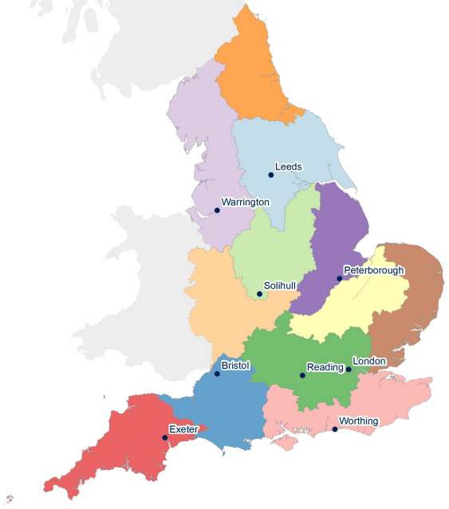
Regional Flood and Coastal Committees
Regional Flood & Coastal Committee (RFCC) is a committee established by the Environment Agency under the Flood & Water Management Act 2010.
They are independent bodies that play a vital role in reducing the risk of flooding and coastal erosion.
The Environment Agency must consult with RFCCs about flood and coastal risk management (FCRM) work in their region and take their comments into consideration.
Each RFCC brings together members appointed by Lead Local Flood Authorities (LLFAs) and independent members with relevant experience who are appointed by the Environment Agency.
The Committee’s chair is appointed by Defra. There are currently 12 RFCCs across England, each covering a distinct regional area based on river catchments
Northumbria
Yorkshire
North West
Anglian
Northern
Anglian
Eastern
Trent
Anglian
Great Ouse
English Severn & Wye
Thames
Wessex
Southern
South West

Slide 10

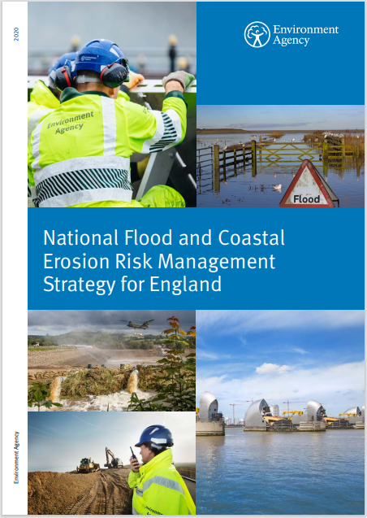
The Environment Agency
Our aim is to increase the resilience of people, property and businesses to the risks of flooding and coastal erosion​.
​
​The Flood and Water Management Act 2010 places a statutory duty on the Environment Agency to develop a National Flood and Coastal Erosion Risk Management Strategy for England. ​
The FCERM Strategy describes what needs to be done by all risk management authorities (RMAs) involved in flood and coastal erosion risk management for the benefit of people and places.
Our FCERM Strategy has three long term ambitions: ​
  Climate resilient places​
  Today’s growth and infrastructure resilient in tomorrow’s climate​
  A nation ready to respond and adapt to flooding and coastal change​
Our Roadmap to 2026 sets out how we progress towards delivering the FCERM Strategy’s vision. ​
RFCCs play a vital role in helping us to achieve our aims and meet the ambitions in the FCERM strategy

Slide 11
Day in the Life of a RFCC Chair
Phil Rothwell
Northumbria RFCC

Slide 12
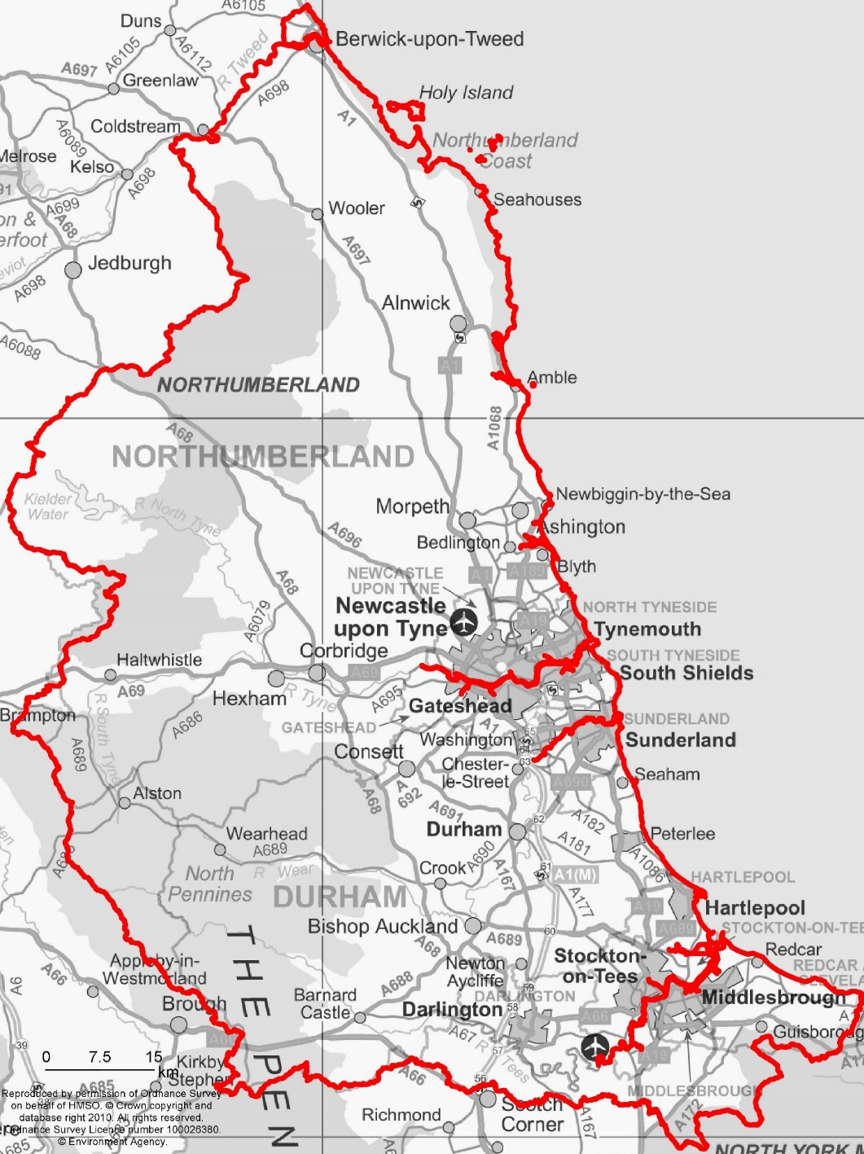

The Northumbria Regional Flood and Coastal Committee
Phil Rothwell (NRFCC Chr)

Slide 13
Membership
Membership - 19
      - NRFCC Chair
      - 12 LLFA elected members
      - 6 Independent Members
      (including 1 Coastal Specialist and 1 Conservation Specialist)
      1 EA Board Member

Slide 14
Programming and Investment (P&I) Subgroup
  Makes recommendations to the Committee on investment and funding issues
  Meets quarterly about two weeks before the RFCC meeting
  Chair from the committee, 2 EA appointed members, 6 LLFA members and 1 Northumbrian Water member

Slide 15
Risk Management Subgroup
  Making recommendations to the Committee on strategic risks to the programme and proposed mitigation
  Established in Aug 21 and meets 1 month before the RFCC meeting
  Membership comprising representatives from each strategic group, Northumbrian Water and topic leads from the Environment Agency

Slide 16

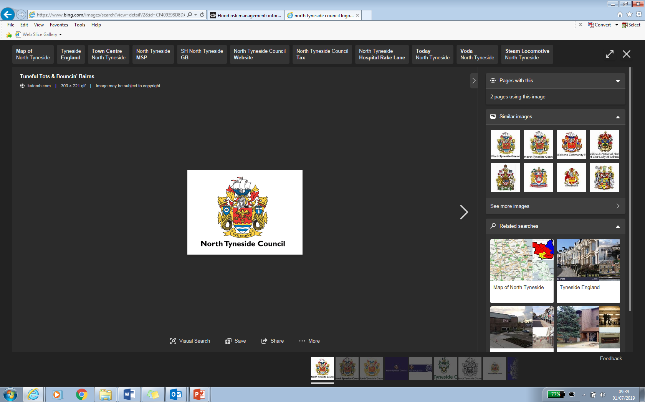


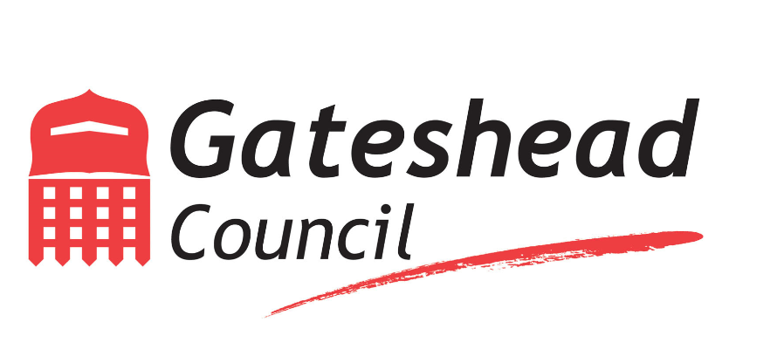


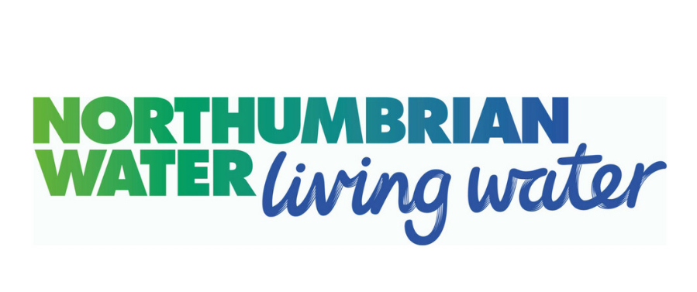

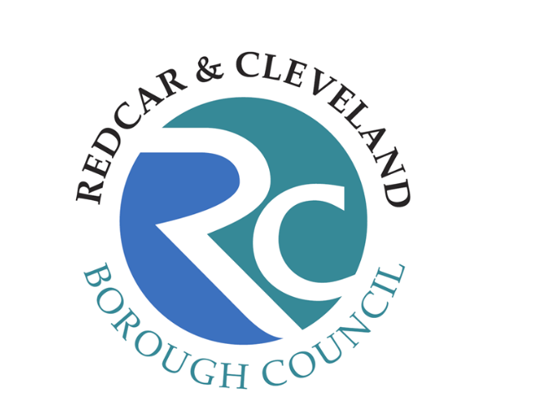
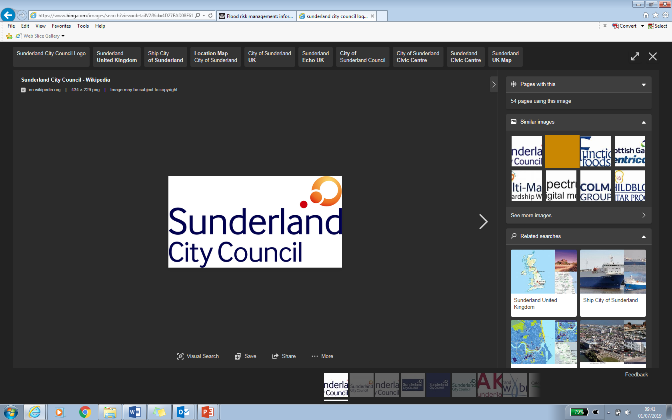
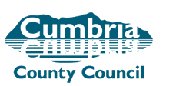

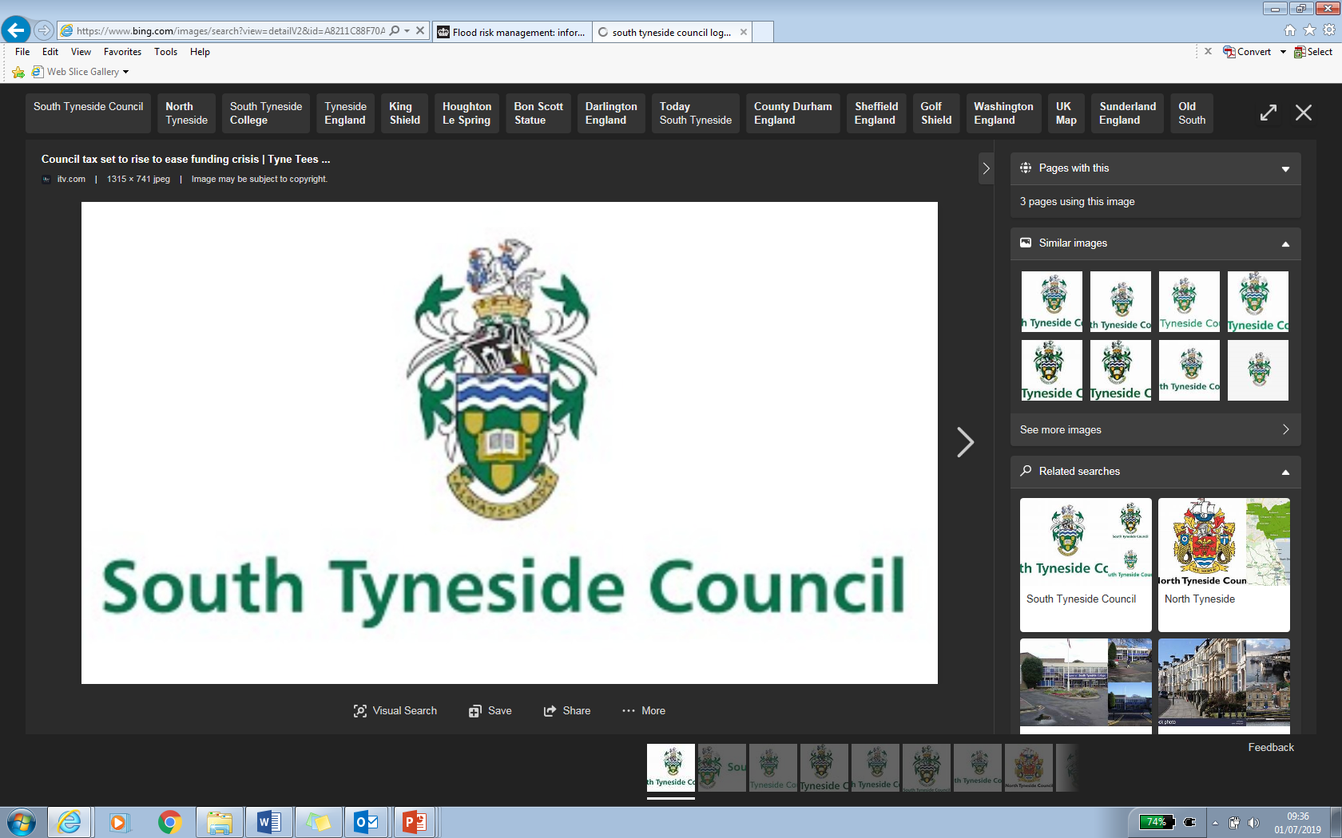
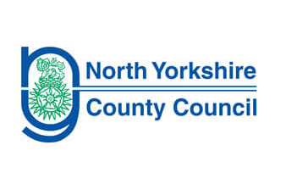
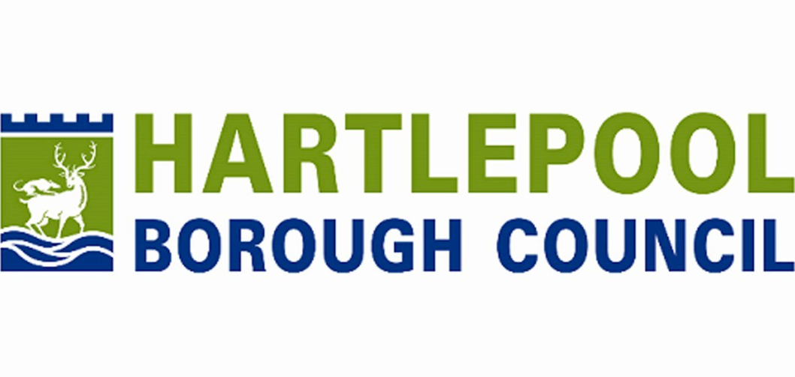

Slide 17


Northumbria Integrated Drainage Partnership (NIDP)
  An integrated approach to investing in flood risk reduction
  Collaboration from scoping of priority areas onwards
  Prioritise areas for studies in a 10 year programme
  Promote integrated sustainable drainage opportunities, including natural flood management techniques
  Establish and implement data sharing and communication protocols
  Integrated Flood Programme Co-ordinator resource

Slide 18
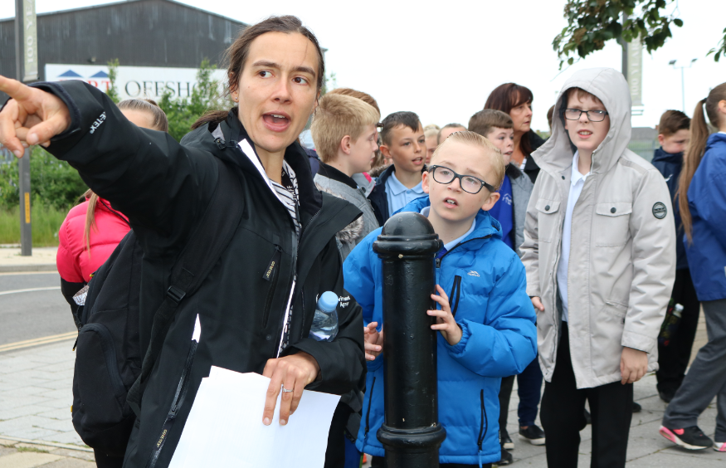


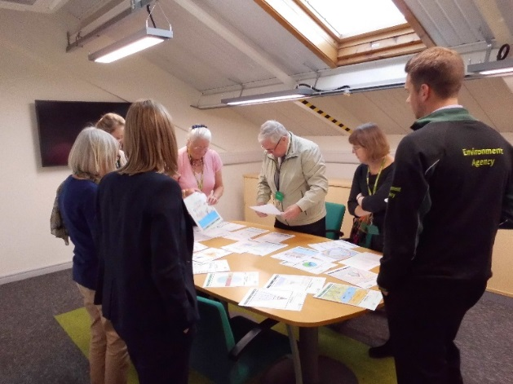

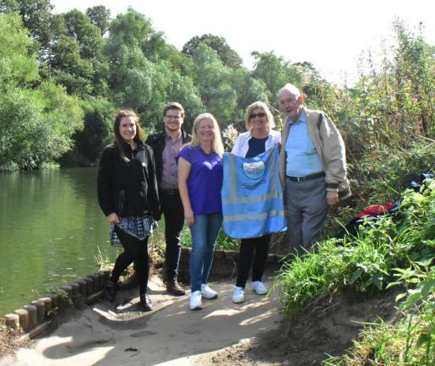
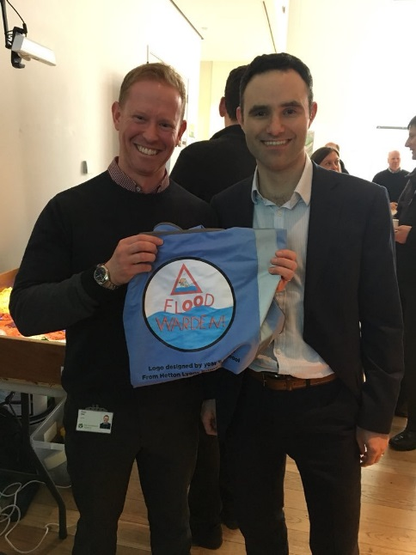
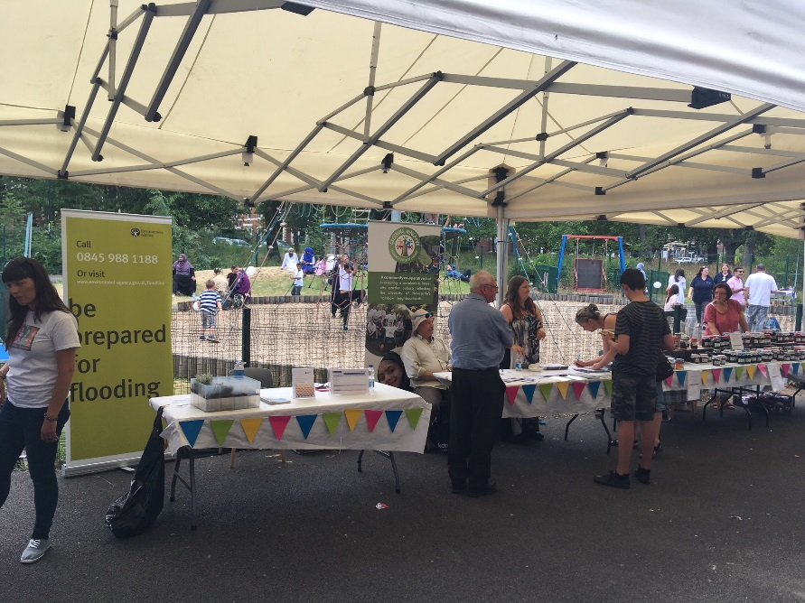
Community Engagement Officers

Slide 19
A week in the life
Dates agree dates RFCC and Envt group
Content – agree future meeting contents
Pre meet with EA staff prior to RFCC
RFCC budget meeting
Speak at launch of film on ground water
Agree agenda for Chairs visit
Agree task and finish group on university and college liaison over skills
Agree joint RFCC chairs letter to Ministers on Infra structure
Agree chairs line on ADA and IDBs
Speak with Water Company on future programme coordination/Ofwat

Slide 20
Questions

Slide 21
Deadline for applications: 28 March 2025
Apply link: https://apply-for-public-appointment.service.gov.uk/roles/8594
Queries: rfcc-correspondence@defra.gov.uk
Notes:
Can contact Phil if needed with more questions.

Slide 22
Thank you for attending

