Slide 1




Met Office Chair
Candidate Pack
Closing Date: 18 March 2024
If you have any questions, require further information, or would like this candidate pack in an alternative format, please contact the Public Appointments team at Partnerships@dsit.gov.uk

Slide 2
Contents
3. Ministerial Foreword
4. About the Met Office
5. The Role
6. Person Specification
7. Terms of Appointment
8. How to Apply
9. Assessment Panel, Process and Timeline
10. Equality, Diversity and Inclusion
11. Annex A: Met Office Purpose, Vision and Values
13. Annex B: Conflicts of Interest and Due Diligence
14. Annex C: The Seven Principles of Public Life
15: Annex D: Complaints Procedure

Slide 3
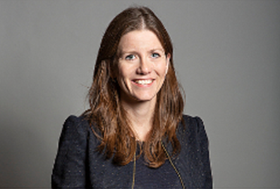
Ministerial Foreword
Dear Candidate
Thank you for your interest in the role of Chair of the Met Office.
The Met Office Board has a vital role in advising and supporting the Chief Executive and the Executive Team to deliver the organisation’s strategic priorities and ensuring that resources are allocated effectively for their delivery. The Board reviews the management and performance of the Met Office and ensures high standards of corporate governance are maintained.
As the UK’s national meteorological service, the Met Office operates across most aspects of national life whether that’s ensuring the safe operation of commercial aviation, enabling our armed forces to deploy around the globe, or keeping British citizens safe in times of severe weather. Met Office activity spans across all sectors of the economy and the services it provides to the public, government and industry underpin national economic growth.
It is a transformational time for the Met Office as they take delivery of a new supercomputer provided by Microsoft in 2024. This significant investment will be the world's first cloud-based weather and climate supercomputer. The new supercomputer will be one of the most powerful in the world and will help enhance the Met Office’s position as a world-leading centre of research and innovation in both weather and climate science. This is a tremendous opportunity to be involved in leading an exceptionally talented and visionary organisation and your role will be key to ensuring the organisation exploits this new investment fully.
If you believe you have the experience and qualities we are seeking to help to lead and support this organisation, we very much look forward to hearing from you.
The Rt Hon Michelle Donelan MP
Secretary of State for Science, Innovation & Technology

Slide 4
About the Met Office
The Met Office is the national meteorological service for the UK. It provides world-leading weather and climate science and services that help government, industry and the public make better decisions to stay safe and thrive. That means providing the best weather and climate information when it matters most. Its focus is on making a difference and delivering greater benefit to UK citizens.
The Met Office can only make an impact when its trusted data, products, science, services and advice get into the hands of those who use it to shape their lives, and the lives of those around them. They deliver services through a vast technological enterprise including a groundbreaking new supercomputing platform. Behind this is a team of excellent people, working to deliver extraordinary impact, making the Met Office one of the most trusted forecasters in the world.
Since its foundation in 1854, the Met Office has pioneered the science of meteorology and its application. To this day, it continues to push the boundaries of science and technology, meeting the demands of today and the future. It is a key part of the weather and climate community, uniting scientific leaders from every corner of the globe, delivering extraordinary impact and benefit to the world around us. Through this it aims to realise its vision of being recognised as global leaders in weather and climate science and services in a changing world.
Further information about The Met Office can be found in Annex A (Purpose, Vision and Values) and here.

Slide 5
The Role
The Met Office Chair is appointed by the Secretary of State for DSIT and will be responsible for advising the Minister on the organisation’s overall direction and performance . The role of Chair is pivotal and demands effective strategic leadership of the Board and the ability to speak on its behalf. The Chair will work closely with the full-time Chief Executive, who is also the Met Office’s Accounting Officer. The Chair has particular responsibility for providing first-rate strategic leadership on matters including:
Leading the Board by facilitating a high standard of discussion and debate, allowing it to provide the appropriate degree of challenge to the executive team. The Chair must ensure systems are in place to provide Board members with appropriate support and the timely, relevant information required for them to perform their role.
Leading the Board to support and challenge the Executive Team in setting the strategic direction of the organisation, including organisational targets and priorities. This will include holding the Executive Team to account for delivering the Met Office’s Corporate Plan centred on the technology transformation through the delivery of new supercomputing capability.
Bringing top-level commercial and strategic insight to the table and using this to challenge and support the Executive Team to ultimately enhance the organisation’s performance as a whole.
Leading on the appointment, induction, and assessment of non-Executive Board Members to ensure a strong Board with an effective mix of skills and being actively involved in the appointment (if relevant) and performance assessment of the Chief Executive.
Ensuring a formal annual evaluation of the Board’s performance and that of its committees and individual Board members, and that the Met Office fulfils its annual reporting requirements and manages taxpayer money to the highest standards.
Working in partnership with the Chief Executive as an ambassador for the Met Office, to maintain and enhance its stellar world leading reputation.
Providing the Minister and DSIT Sponsor with the Board’s perspective on strategic matters and other relevant issues as required. This includes ensuring that the Board takes proper account of guidance provided by the Minister and Secretary of State for DSIT.

Slide 6
Person Specification
The Secretary of State is seeking applications from individuals with top-level strategic experience commensurate with the responsibilities and the challenges of the Met Office. Applicants are invited from both public and commercial settings. We are looking for an exceptional candidate with experience of leading a board of senior non-executive and executive directors, and a proven track record of ensuring high levels of engagement and performance. The successful applicant will need to demonstrate the following:
Essential Criteria
Previous experience as a senior chair or senior Non-Executive Director of a substantial company or organisation.
Senior (preferably in executive capacity) level experience of oversight and implementation of transformational IT and workforce change programmes at the organisational level – preferably involving IT and workforce elements.
Comfortable in an environment of fast-paced technological change.
Demonstrable senior commercial experience, with the ability to accept personal accountability for results.
Desirable Criteria
Experience in delivery or oversight at a large organisation that has seen a transformational upgrade in its core technology infrastructure and maximised the exploitation of the investment.
Understanding how technological, scientific and/or environmental research can be exploited to deliver socio-economic impact.

Slide 7
Terms of Appointment
Appointment Term: An initial period of 3 years.
Remuneration: £35,000 per annum. Remuneration and expenses are taxable.
Time Commitment: 36 days per annum.
Location: Exeter.
Nature of Appointment: This is a Ministerial Appointment by the Secretary of State for Science, Innovation and Technology. The post holder would be an officeholder and not be an employee of the Department or the Met Office.
Availability: The successful candidate/s will be encouraged to take up their appointment as soon as possible, following the successful completion of pre-appointment checks and security clearance at Baseline Personnel Security Standard (BPSS) level (with an expectation of a move to at least Security Check (SC) vetting in due course). Further details can be found here https://www.gov.uk/government/publications/united-kingdom-security-vetting-clearance-levels/national-security-vetting-clearance-levels.

Slide 8
How to Apply
Applications must be submitted by 23:00 on 18/03/2024. Applications received after this date will not be considered
In order to apply you will need to create an account or sign in. Once you are logged into your account, click on ‘apply for this role’ and follow the on-screen instructions. To apply, all candidates are required to provide;
A Curriculum Vitae (CV)
A supporting statement
Equality information
Information relating to any outside interests or reputational issues
We will ask you to check and confirm your personal details to ensure your application is accurate.
You will also have the opportunity to make a reasonable adjustment request or apply under the disability confident scheme before you submit your application.

Slide 9
Assessment Panel, Process and Timeline
Candidates will be sifted and interviewed by an Advisory Appointment Panel (AAP). Scoring at sift and interview is based on the criteria set out in the Person Specification. The AAP will determine which candidates are appointable.
The Secretary of State will appoint on merit from the list of appointable candidates.
Date | Actions
18 March 2024 | Application Deadline
w/c 15 April 2024 | Shortlisting
w/c 27 May 2024 | Interviews
June 2024 | Successful candidate notified
June 2024 | Appointment announced
The above timeline is indicative and subject to change.
The members of the AAP are:
Departmental Representative & Panel Chair – Alex Jones, Director General Science and Innovation
Independent Panel Member – Stephen Lake, Chair of Ordnance Survey
Additional Panel Member – Dave Smith, National Technology Adviser

Slide 10
Equality, Diversity and Inclusion
We are committed to increasing the diversity of our boards and bringing in talent, regardless of its origins. We encourage applications from all candidates, regardless of ethnicity, religion or belief, gender, sexual orientation, age, disability or gender identity. We particularly welcome applications from people with ethnicity, gender and disability characteristics currently underrepresented on our Boards.
Arrangements for candidates with a disability:
As a Disability Confident leader, we guarantee to interview anyone with a disability whose application meets the essential criteria for the post. More details on the criteria can be found in this pack. If you wish to apply through the Disability Confident scheme, you will need to tick the option on the Diversity Monitoring form that you will submit alongside your application.
Adjustments:
All candidates are entitled to request reasonable adjustments at any stage of the application process. If you would like to discuss adjustments prior to submitting your application, please contact partnerships@dsit.gov.uk

Slide 11
Annex A: Met Office Vision and Purpose
“
“
Helping you make
better decisions to
stay safe and thrive.
”
”
“
Recognised as global leaders in weather and climate science and services in our changing world
“
”

Slide 12
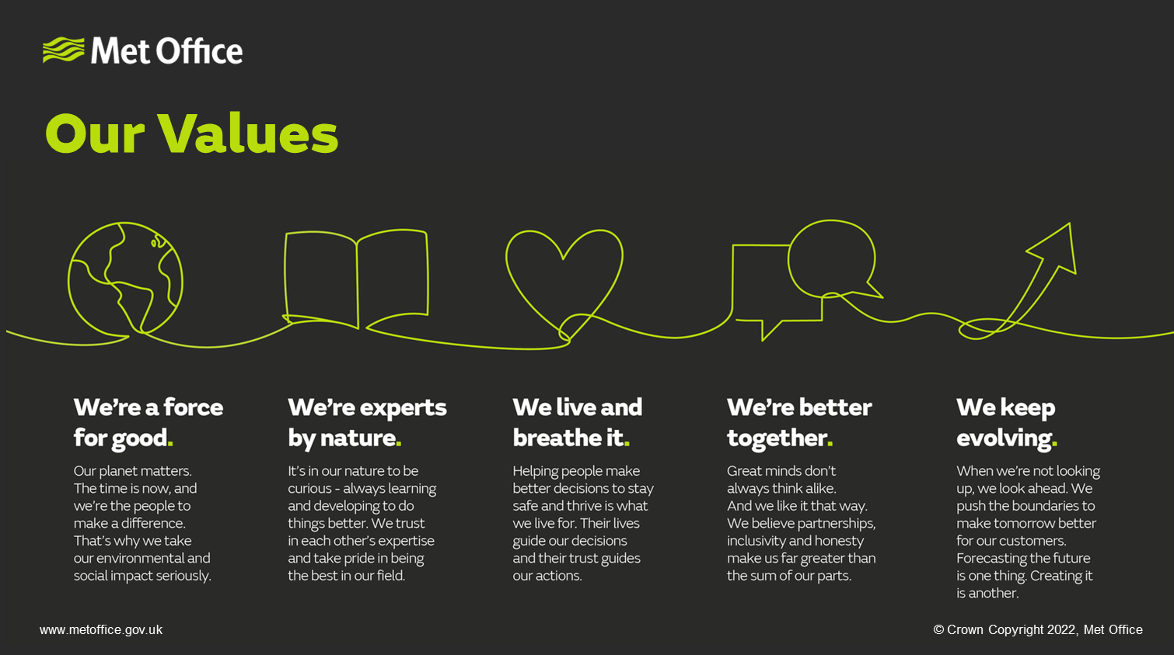
Annex A (continued): Met Office Values

Slide 13
Annex B: Conflict of Interest and Due Diligence
Public Appointments require the highest standards of propriety, involving impartiality, integrity and objectivity, in relation to stewardship of public funds and the oversight and management of all related activities. This means that any private, voluntary, charitable or political interest that might be material and relevant to the work of the body concerned should be declared.
It is important that those appointed as members of public bodies maintain the confidence of Parliament and the public. If there are any issues in your personal or professional history that could, if you were appointed, be misconstrued, cause embarrassment, or cause public confidence in the appointment to be jeopardised, it is important that you bring them to the attention of the Assessment Panel and provide details of the issue(s) in your application. In considering whether you wish to declare any issues, you should also reflect on any public statements you have made, including through social media. The Panel may explore issues with you before they make a recommendation on the appointment.
As part of our due diligence checks we will consider anything in the public domain related to your conduct or professional capacity. This will include us undertaking searches of previous public statements and social media, blogs or any other publicly available information. This information may be made available to the Panel, and they may wish to explore issues with you, should you be invited to interview.
If you have any queries or would like to discuss further, please contact partnerships@dsit.gov.uk.

Slide 14
Annex C: The Seven Principles of Public Life
In 1995 the Committee on Standards in Public Life defined seven principles for public life. All candidates for are expected to demonstrate a commitment to, and an understanding of, the value and importance of the principles of public service which are:
Selflessness
Integrity
Objectivity
Accountability
Openness
Honesty
Leadership
Further information on the principles of public life can be found here.

Slide 15
Annex D: Complaints Procedure
If you feel you have reason to complain you should direct your concerns in the first instance to the Public Appointments team at partnerships@dsit.gov.uk who will make every effort to deal with these and respond to you within 48 hours.

