Slide 1

Supported Housing Advisory Panel
Panel Members
Information Pack for Candidates
Closing Date: 12.00pm on 9 December 2024

Slide 2
Contents
Section Page no.
About the Supported Housing Advisory Panel 3
Role Description and Key Responsibilities 4
Selection Criteria 5-6
Terms and Conditions 7
How to Apply 8
Assessment Process: Overview 9
Assessment Process: Indicative Timeline 10
Diversity and Equal Opportunities 11
Further Information 12
GDPR 13
Seven Principles of Public Life 14

Slide 3
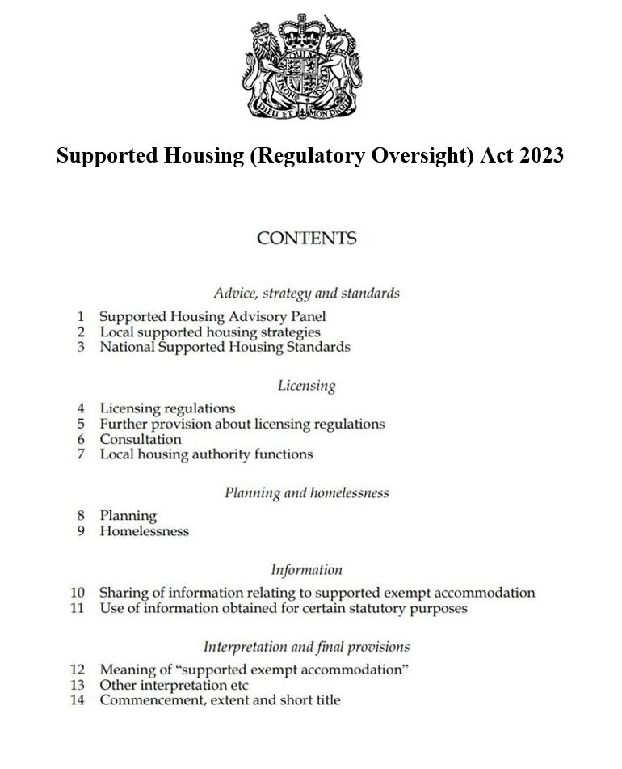
The Supported Housing Advisory Panel
The Supported Housing Advisory Panel is a new Expert Committee that the Secretary of State is establishing in accordance with the Supported Housing (Regulatory Oversight) Act. The Act received Royal Assent on 29 June 2023.
The Panel will include members that represent the interests of:
residents or potential residents of supported exempt accommodation
registered providers of social housing in England
local housing authorities in England
social service authorities in England
charities providing supported exempt accommodation
The focus of the Panel will be delivering better outcomes for residents, and a fairer, more just approach to supported housing for the most vulnerable, as the measures in the Supported Housing (Regulatory Oversight) Act are developed and implemented. The Panel will be able to provide independent feedback to the Government on the impact of the measures on the supported housing sector.

Slide 4
Role Description and Key Responsibilities
Members of the Advisory Panel will provide information, advice, and challenge about or in connection with supported housing.
Key Responsibilities
You will work with the other members using your expertise to advise on:
  Whether the proposed Government reforms will make a difference to the quality of both the accommodation and support provided to supported housing residents.
  Challenges and risks to delivering the measures in the Supported Housing (Regulatory Oversight) Act, including any unintended consequences for supply and the deliverability of supported housing.
  Impacts on supported housing residents, providers, local authorities.
You will be able to provide the Secretary of State with clear advice as required. You will provide advice to inform the review of the licensing scheme, which will take place within three years of the schemes being introduced.
Additionally, you will highlight current and emerging issues in the supported housing sector that have the potential to impact on our strategic objectives for supported housing below, and more generally the viability and operations of supported housing schemes.
Before your membership ends you and the other panel members will undertake a review of the Panel’s effectiveness in ensuring the smooth delivery of the Act and mitigating the impacts. The panel will provide advice on what further reforms may be required.
Strategic Objectives
All supported housing meets quality standards, including of accommodation and support services.
Supported housing should deliver genuine support to vulnerable people
Supported housing delivers better value for money to the public purse.
Better strategic planning for all types of supported housing, to include better integration and delivery through health, social care and housing and planning authorities.

Slide 5
Supported Housing Advisory Panel Member
Selection Criteria
Essential Criteria
You must be at Director level or above in your organisation, or of an equivalent level of seniority, and you must either be able to demonstrate how you represent the interests of one or more of the categories set out below or demonstrate how you are suitable for this role, having regard to the strategic objectives set out on the previous slide:
  residents or potential residents of supported exempt accommodation
  registered providers of social housing in England
  local housing authorities in England
  social service authorities in England
  charities providing supported exempt accommodation
A wide range of cross-cutting expertise in supported housing and strong analytical skills with an ability to get to grips with complex issues.
The ability to provide insight into what is happening on the ground and be alert to new and emerging trends.
Excellent communication, interpersonal and engagement skills with the ability to contribute constructively to collective decision-making processes by listening to others and earning the respect of colleagues.
The ability to work effectively with others to challenge, support and hold an organisation to account for the delivery of strategic aims and objectives.

Slide 6
Supported Housing Advisory Panel Member
Selection Criteria
Desirable criteria
Innovators, who can demonstrate they can bring new ideas and good practice grounded in sound knowledge of housing and the needs of vulnerable people.
Credible individuals who understand the complexity of the sector and are enthusiastic and committed to improving the quality of supported housing.
A strong track record of making effective decisions on significant issues within the private, public or voluntary sectors.

Slide 7
Terms and Conditions
Remuneration: £10,800 per annum (equivalent to £450 per day). This remuneration is treated as employment income and will be subject to tax and National Insurance contributions, both of which will be deducted at source under PAYE before you are paid.
Time Commitment: Your time commitment is expected to be 2 days per month. This includes including attendance at quarterly Panel meetings and associated work, and any additional meetings that the role requires.
Term: Appointments are made by Ministers for a period of up to 5 years.
Location: Meetings will mainly be held on Microsoft Teams or at 2 Marsham Street, Westminster, SW1P 4DF.
Expenses and Subsistence:
Reasonable travel and subsistence expenses incurred on Supported Housing Advisory Panel business will be reimbursed in accordance with MHCLG policies.
Conduct:
The Members will be expected to act in accordance with:
The principles set out in the Cabinet Office’s Code of Conduct for Board Members of Public Bodies. The Code sets out, clearly and openly, the standards expected from those who serve on the boards of UK public bodies and will form part of individual members’ terms and conditions of appointment; and
The Seven Principles of Public Life.
Nationality:
You must have a right to work in the UK, there must be no employment restrictions, or limit on your permitted stay in the UK.
Annual Performance Review and Reappointment:
Annual performance reviews are expected to be undertaken by the MHCLG Senior Sponsor or relevant person. Reappointments are not automatic and will only be considered subject to satisfactory performance reviews.

Slide 8
How to Apply
Please submit the required documentation listed at 1-3 below to SupportedHousingOversight@communities.gov.uk by 12.00 pm on 9 December 2024. If not provided your application will not be taken forward. Late applications will not be considered.
Please include ‘Supported Housing Advisory Panel – Panel Member: General’ as the subject line of your email.
1. Curriculum Vitae (maximum 2 pages). Include your education, professional qualifications and full employment history.
2. An accompanying Supporting Letter (maximum 2 pages). Please set out your suitability for the role and how you meet the Selection Criteria. We suggest you use specific examples to demonstrate how you meet the criteria. If you can offer experience in more than one of the areas referenced above, there is no need to submit more than one supporting letter against the criteria - just clearly reference and example those criteria in a single supporting letter.
3. Application and Diversity Information Form. This is an online form https://forms.office.com/e/EARLeXCCcP. You should declare any potential issues including conflicts of interest (perceived, potential or actual). This includes your personal or professional history that could, if you were appointed, be misconstrued, cause embarrassment to the Supported Housing Advisory Panel, MHCLG or HM Government, or cause public confidence in the appointment to be jeopardised. The Panel will explore your declarations during the interview process. Failure to disclose such information could result in an appointment either not being made or being terminated.
Candidates should note that ‘due diligence’ will be carried out as part of the assessment process if you are called to interview and will be shared with the interview Panel and Ministers. This will include searches on social media, blogs and/or other publicly available information.
Diversity data will be treated in confidence and is used for data gathering information only and will not affect your application. Please complete the Disability Confident section if relevant.
You will receive an automated acknowledgement of your application.

Slide 9
Assessment Process: Overview
These appointments will be made on the basis of merit, in accordance with the Cabinet Office Governance Code on Public Appointments. The decision on who to appoint is made by Ministers, who receive advice from the Interview Assessment Panel on the suitability of candidates against the published selection criteria.
The timeline provided is indicative and could be subject to change. If you are unable to meet these timeframes, please let us know by contacting SupportedHousingOversight@communities.gov.uk .
The Advisory Assessment Panel will be:
Cathy Page, Deputy Director, Housing with Care and Support and MHCLG Panel Chair, MHCLG
MHCLG Panel Member (TBC)
Independent Panel Member (TBC)
Due to the high volume of applications we receive, we only provide feedback to candidates who reach the interview stage and will only be provided once the campaign has concluded.

Slide 10
Assessment Process
Indicative Timeline
The timeline provided is indicative and could be subject to change, potentially at short notice. If you are unable to meet these timeframes, please let us know by contacting SupportedHousingOversight@communities.gov.uk
Closing date: 9 December 2024
Shortlisting: January 2025 (TBC)
Panel interviews: February 2025 (TBC). Interviews will be conducted remotely.
Copies of passports will need to be provided prior to interview in order to check candidates’ identity.
The Minister may choose to meet with the candidates before making a decision.
Provisional start date TBC
Please note: The time taken between interview and a final appointment decision being made can sometimes take a number of weeks. Candidates who have been interviewed will be kept informed of progress.

Slide 11
Diversity and Equal Opportunities
MHCLG is committed to the principle of Public Appointments on merit with independent assessment, openness and fairness of the process and providing equal opportunities. Applications are welcome from all, we particularly encourage applications from women, people from ethnic background, people with disabilities and other under-represented groups.
Panel meetings will be primarily based in in London however, meetings may take place in other locations around the UK or via video conferencing. If you believe you have the experience and qualities we are seeking, we look forward to receiving your application.
Disability Confident
As a Disability Confident employer, we will ensure that a fair and proportionate number of disabled applicants that meet the minimum criteria for this position will be offered an interview. By ‘minimum criteria,’ we mean that you must provide evidence in your application, which demonstrates that you meet the level of competence required under each of the essential criteria. If you wish to apply under this scheme, please complete the declaration in the on-line application form. It is not necessary to state your disability.
Reasonable Adjustments
If you would like a confidential discussion regarding any reasonable adjustments during the process, please indicate this in the email covering your application or contact SupportedHousingOversight@communities.gov.uk . You do not need to apply under the Disability Confident Scheme to ask for a reasonable adjustment.

Slide 12
Further Information
Contact: For further information about the roles or application process please contact SupportedHousingOversight@communities.gov.uk . Please put ‘Supported Housing Advisory Panel/Member’ as the subject line of your email.
Complaints: If you feel this competition has not been conducted fairly and you wish to make a complaint, you should initially contact the Appointments Team at SupportedHousingOversight@communities.gov.uk .

Slide 13
GDPR
We will process your application in accordance with the General Data Protection Regulations and Data Protection Act 2018. Your data will be held securely and processed for the purpose of the recruitment process. Access will be restricted to those dealing with your application or involved in the recruitment process, this will include Ministers and Special Advisers.
Data may also be shared with Cabinet Office, in order to comply with the Public Appointments Governance Code, article 3.1 of the Public Appointments Order in Council 2019. Data may also be shared with Cabinet Office and The Commissioner for Public Appointments in order to meet the public equality duty as set out in the Equality Act, s149. The Commissioner may also request access as part of a complaint investigation or review of the recruitment process.
Your data will be stored for 2 years, if appointed your data will be stored for the duration of your tenure and may be shared with the organisation that you are appointed too, unless specifically requested otherwise. Should you wish your data to be removed from our records, please contact PublicAppointments@communities.gov.uk.
Complaints:
If you consider that your personal data has been misused or mishandled, you may make a complaint to the Information Commissioner who can be contacted at:
Information Commissioners Office
Wycliffe House
Water Lane
Wilmslow
Cheshire
SK9 5AF
0303 123 1113 email: casework@ico.org.uk.
The data controller for Public Appointments is joint between MHCLG and the Cabinet Office.

Slide 14
Seven Principles of Public Life
In 1995 the Committee on Standards in Public Life defined seven principles which should underpin all who serve the public. It is important that members of public bodies maintain the confidence of Parliament and the public. Consistent with the Governance Code, applicants will be assessed on merit, and all candidates will need to uphold the standards of conduct set out in these principles that will be tested during the selection process. Failure to disclose such information could result in an appointment either not being made or being terminated. Should you wish to speak to someone concerning a potential conflict of interest or other issues please contact a member of the Public Appointments team at PublicAppointments@communities.gov.uk in the first instance.
Selflessness Holders of public office should act solely in terms of the public interest.
Integrity Holders of public office must avoid placing themselves under any obligation to people or organisations that might try inappropriately to influence them in their work. They should not act or take decisions in order to gain financial or other benefits for themselves, their family or their friends. They must declare and resolve any interests and relationships
Objectivity Holders of public office must act and take decisions impartially, fairly and on merit, using best evidence and without discrimination or bias.
Accountability Holders of public office are accountable to the public for their decisions and actions and must submit themselves to the scrutiny necessary to ensure this.
Openness Holders of public office should act and take decisions in an open and transparent manner. Information should not be withheld from the public unless there are clear and lawful reasons for doing so.
Honesty Holders of public office should be truthful.
Leadership Holders of public office should exhibit these principles in their own behaviour. They should actively promote and robustly support the principles and be willing to challenge poor behaviour wherever it occurs.

