Slide 1


Insolvency Service, Non-Executive Director, (x1)
Candidate Pack
Closing date: 16 October 2023

Slide 2
Contents
03: Ministerial Foreword
04: The Insolvency Service
05: The Role
06: Diversity
07: Person Specification
08: Criteria
09: Terms of Appointment
10: How to apply
11: Assessment Panel, Process and Timing
12: Annex A – Conflicts of Interest and Due Diligence
13: Annex B – The Seven Principles of Public Life
14: Annex C – Complaints

Slide 3
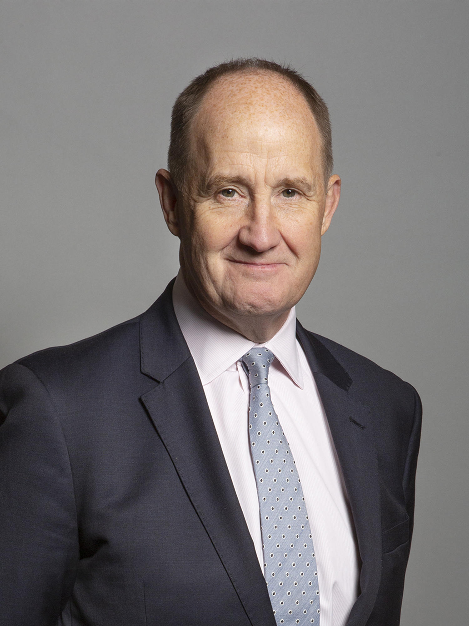
Ministerial Foreword
Dear Candidate,
Thank you for your interest in the role of Non-Executive Director at the Insolvency Service.
The Insolvency Service is an Executive Agency of the Department for Business and Trade, responsible for helping to deliver economic confidence by supporting those in financial distress, tackling financial wrongdoing and maximising returns to creditors. It employs around 1,700 staff operating from 22 locations across Great Britain.
We are seeking to appoint a new Non-Executive Director to support the and Board of the Insolvency Service to lead the organisation as it takes forward its programme of transformation, delivers key Government commitments, and continues its record of strong performance against the backdrop of an uncertain economy. We are particularly keen to appoint someone with deep knowledge in personal bankruptcy who can challenge and support the Agency on the proposed reforms currently being framed.
Headed by the non-executive Chair, the Board currently comprises a mix of Executive and Non-Executive Directors. The Board is collectively responsible for the oversight of the operation of the Insolvency Service, with particular emphasis on its strategic direction, management controls, and corporate governance. All Non-Executive Directors contribute meaningfully to decisions covering the strategy for the organisation and the overall direction of the business, adding value by offering wise counsel, advice and challenge, based on their own experience and successful track records of achievement in relevant areas of expertise.
The Board meets up to ten times a year, at the HQ in Stratford but as occasion demands at other organisation offices around the country.
Kevin Hollinrake MP
Minister for Small Business, Consumers and Labour Markets

Slide 4
The Insolvency Service
The Insolvency Service are a government agency that helps to deliver economic confidence by supporting those in financial distress, tackling financial wrongdoing and maximising returns to creditors.
The Insolvency Service is an executive agency, sponsored by the Department for Business and Trade. With their headquarters based in London, they have around 1,700 staff operating from 22 locations across Great Britain.
The Insolvency Service are responsible for administering bankruptcies and debt relief orders, investigating liquidation affairs of companies, and misconduct of company directors subject to formal insolvency proceeding, or companies that have been dissolved. It also issues redundancy payments, from the National Insurance Fund, and advises DBT Ministers and other governments on insolvency and redundancy related issues.
Further information about The Insolvency Service can be found via: https://www.gov.uk/government/organisations/insolvency-service

Slide 5
The Role
Role Purpose: All Non-Executive Directors (NEDs) contribute substantially to decisions covering the strategy for the organisation and the overall direction of the business value. They offer wise counsel, advice and challenge, based on their own experiences and successful track records of achievement within competitive environments.
The incoming NED will have the following responsibilities:
Provide advice, guidance and challenge to the Chief Executive and Executive Directors to support sound strategic and collective decision making in the Insolvency Service.
Support the delivery of the strategic priorities and contribute to developing and deciding long-term strategies, using skills, experience and judgement to scrutinise the short and long-term performance of the organisation.
Ensure the integrity of financial information is maintained, and that financial controls, systems and risk management are kept robust and defensible.

Slide 6
Diversity
We are committed to increasing the diversity of our boards and bringing in talent, regardless of its origins. We encourage applications from all candidates regardless of ethnicity, religion or belief, gender, sexual orientation, age, disability or gender identity. We particularly welcome applications from people with ethnicity, gender and disability characteristics currently underrepresented on our Boards.
Arrangements for candidates with a disability: As a Disability Confident leader, we guarantee to interview anyone with a disability whose application meets the essential criteria for the post. More details on the criteria can be found in this pack. If you wish to apply through the Disability Confident scheme, you will need to tick that option on the Diversity Monitoring form that you will submit alongside your application.
Adjustments: All candidates are entitled to request reasonable adjustments at any stage of the application process. If you would like to discuss reasonable adjustments prior to submitting your application, please contact dbtappointments@businessandtrade.gov.uk

Slide 7
Criteria
For the role you must demonstrate the following essential criteria:-
A deep knowledge as a practitioner, charity leader or academic in personal bankruptcy so as to be able to challenge and support the proposed programme of reform.
A performance history of building and sustaining relationships with key stakeholders, responding to and balancing the differing needs of those stakeholders.
Independence of judgement and the capacity to bring a fresh and external view to decision-making, through the analysis of complex information to reach practical decisions.
Outstanding communication skills, high level of personal impact and the ability to provide constructive and independent challenge and support to the Board.

Slide 8
How to Apply
In order to apply you will need to create an account or sign in. Once you are logged into your account, click on 'apply for this role' and follow the on-screen instructions. To apply, all candidates are required to provide:​
a Curriculum Vitae (CV)​
a supporting statement​
equality information​
information relating to any outside interests or reputational issues​
We will ask you to check and confirm your personal details to ensure your application is accurate.​
You will also have the opportunity to make a reasonable adjustment request or apply under the disability confident scheme before you submit your application.

Slide 9
Terms of Appointment
Appointment Term: An initial period of three years.
Remuneration: £11,000 per annum. Remuneration and expenses are taxable.
Time Commitment: 20 days per year.
Location: HQ in Stratford, London, and other offices as necessary
Nature of Appointment: This is a Ministerial Appointment by the Secretary of State for Department for Business and Trade. The post holder would be an officeholder and not be an employee of the Department or the Insolvency Service.
Availability: Successful candidate/s will be encouraged to take up their appointment as soon as possible, following the successful completion of pre-appointment checks and security clearance (at BPSS level).

Slide 10
Assessment Panel, Process and Timing
The members of the Advisory Assessment Panel are:
Eoin Parker, Panel Chair and DBT Representative, Director for Business Frameworks
Mark Austen, Representative of Partner Organisation, Chair of INSS
Alison Walker-Fraser, Independent Panel Member
The timelines for this campaign is indicative and subject to change. Please check the advert, here for any updates. | Please note, all dates are indicative and subject to change)
Advert Closes | 16th October
Panel Sift | W/C 30th October
Panel Interview | W/C 20th November
Candidates notified of the outcome | End of December
Appointment confirmed | December/January

Slide 11
Annex A: Conflicts of Interest and Due Diligence
Public Appointments require the highest standards of propriety, involving impartiality, integrity and objectivity, in relation to stewardship of public funds and the oversight and management of all related activities. This means that any private, voluntary, charitable or political interest that might be material and relevant to the work of the body concerned should be declared.
It is important that those appointed as members of public bodies maintain the confidence of Parliament and the public. If there are any issues in your personal or professional history that could, if you were appointed, be misconstrued, cause embarrassment, or cause public confidence in the appointment to be jeopardised, it is important that you bring them to the attention of the Assessment Panel and provide details of the issue(s) in your application. In considering whether you wish to declare any issues, you should also reflect on any public statements you have made, including through social media. The Panel may explore issues with you before they make a recommendation on the appointment.
As part of our due diligence checks we will consider anything in the public domain related to your conduct or professional capacity. This will include us undertaking searches of previous public statements and social media, blogs or any other publicly available information. This information may be made available to the Panel, and they may wish to explore issues with you, should you be invited to interview.
If you have any queries or would like to discuss further, please contact dbtappointments@businessandtrade.gov.uk

Slide 12
Annex B: The Seven Principles Underpinning Public Life
In 1995 the Committee on Standards in Public Life defined seven principles for public life. All candidates for are expected to demonstrate a commitment to, and an understanding of, the value and importance of the principles of public service which are:
Selflessness
Integrity
Objectivity
Accountability
Openness
Honesty
Leadership
Further information on the principles of public life can be found here.

Slide 13
Annex C: Complaints Procedure
If you feel you have reason to complain you should direct your concerns in the first instance to Abigail Obeng at dbtappointments@trade.gov.uk who will make every effort to deal with these and respond to you within 48 hours.
If your complaint is not dealt with satisfactorily, you can find information about the steps you can take under BEIS Complaints Procedure here

