Slide 1
Educationalist Board Member (Primary)
School Teachers’ Review Body
Applicant information pack
October 2022

Slide 2
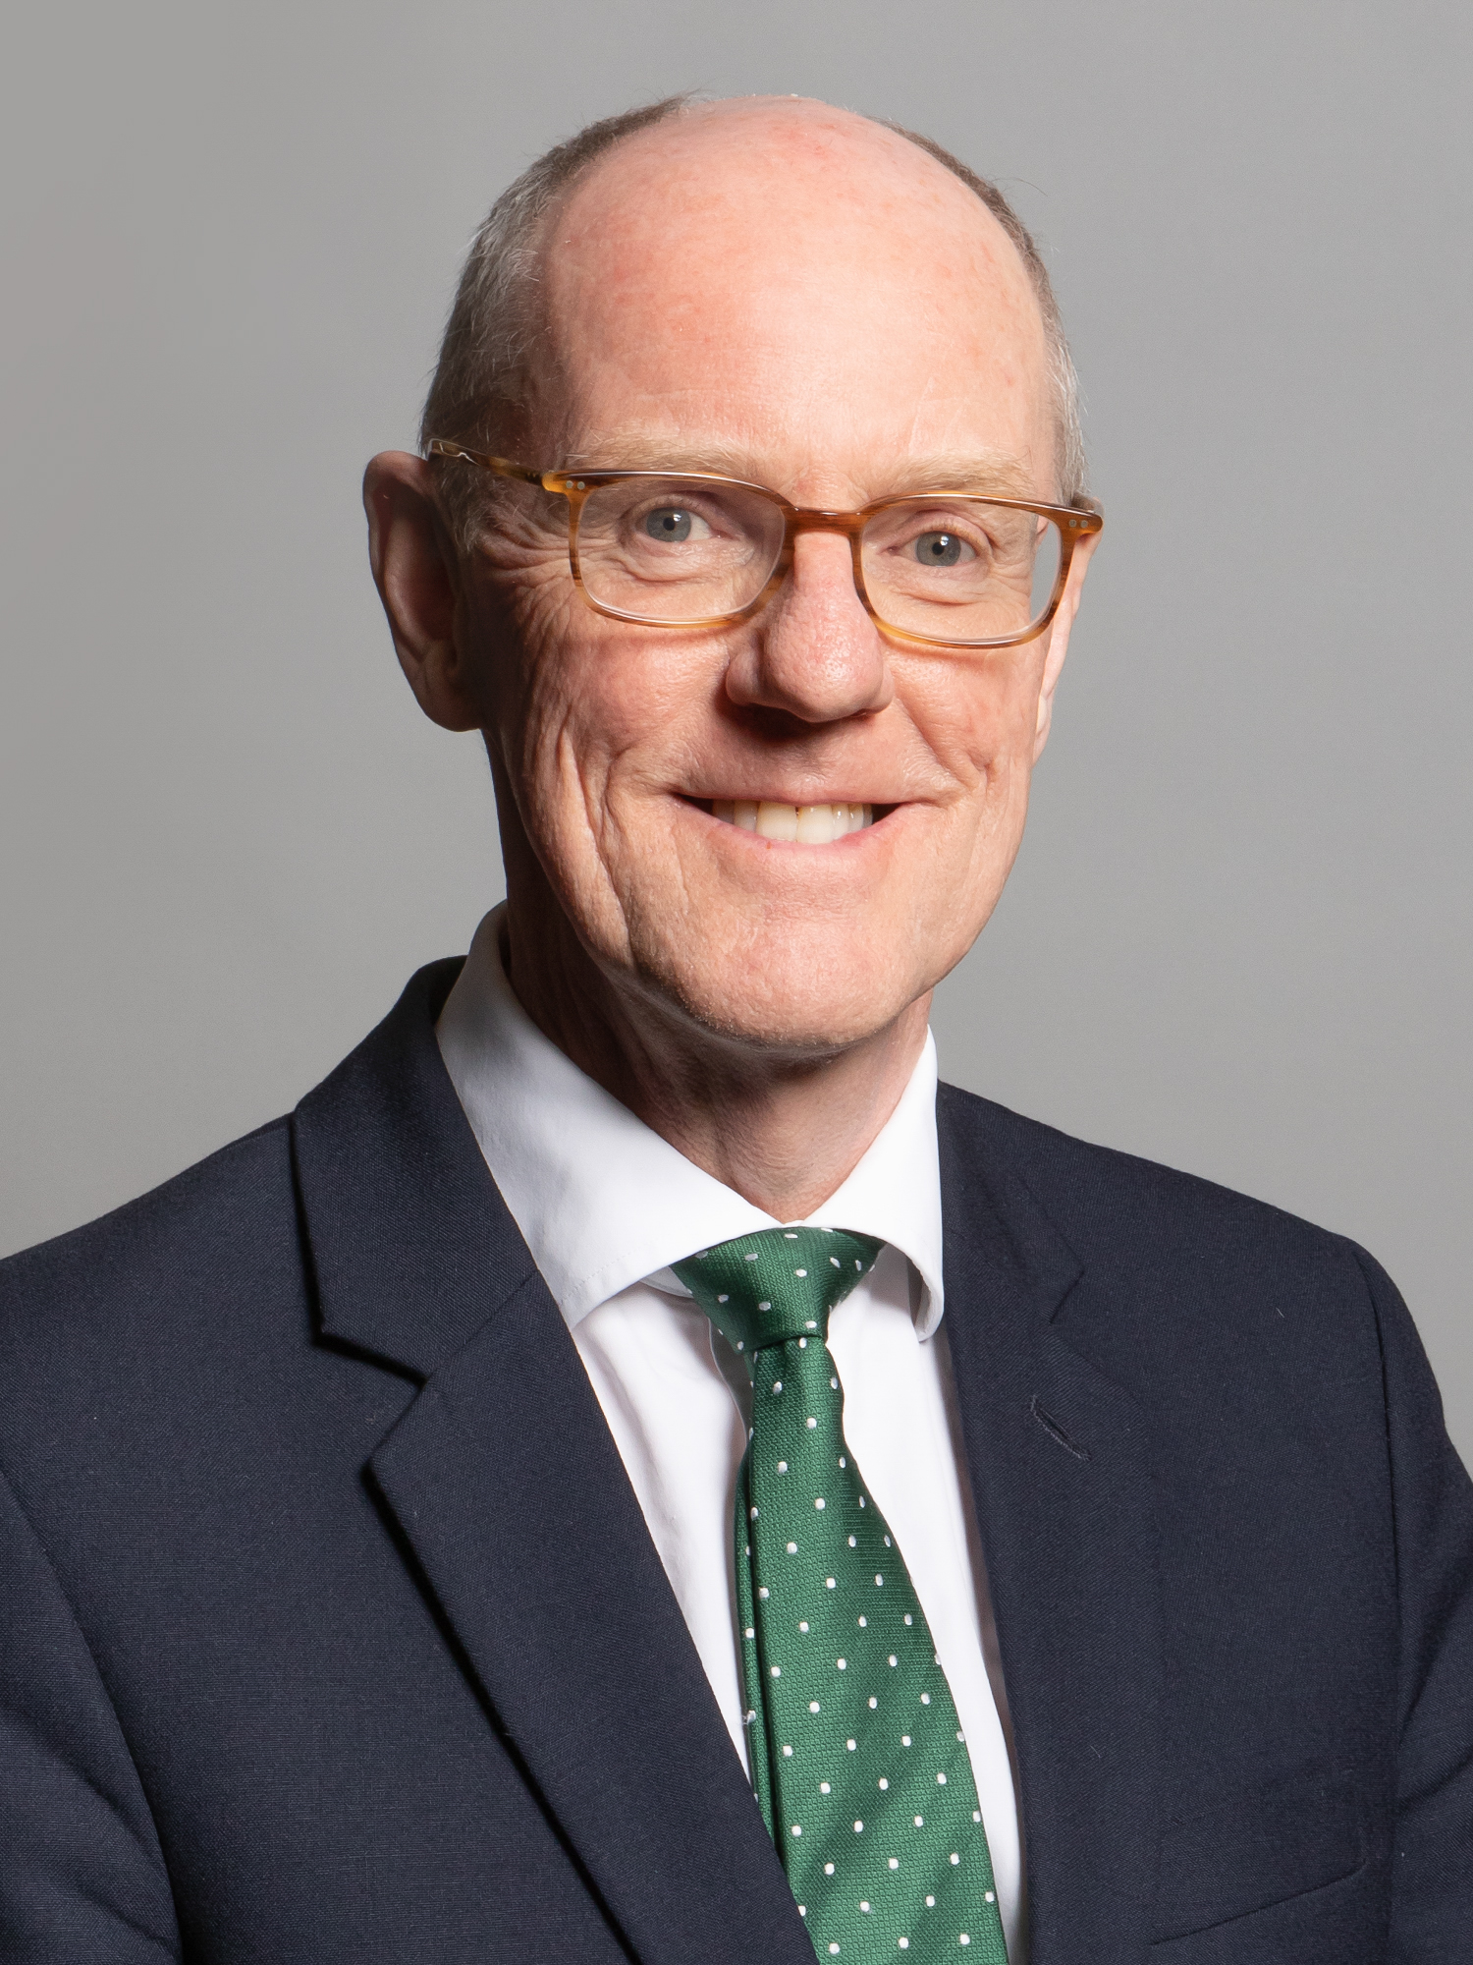
Thank you for your interest in becoming a board member on the School Teachers’ Review Body.
Teachers are the single biggest determinant of pupil outcomes in schools and the Government is committed to ensuring we have a sufficient, high quality supply of teachers.
Pay has an important role in ensuring that teaching is seen as a prestigious and highly regarded profession.
Welcome
As a member of the School Teachers’ Review Body, you will play an invaluable role in making independent, evidence based recommendations on teachers’ and leaders’ pay awards across England. You will also provide advice on wider reforms to pay and conditions to support the recruitment and retention of the best teachers.
The Department for Education remains focused on equality of opportunity, and is committed to ensuring public appointments better represent the views of the communities they serve. The Department encourages applicants from underrepresented groups, those based outside London and the South East.
Rt Hon Nick Gibb - Minister of State for Schools

Slide 3
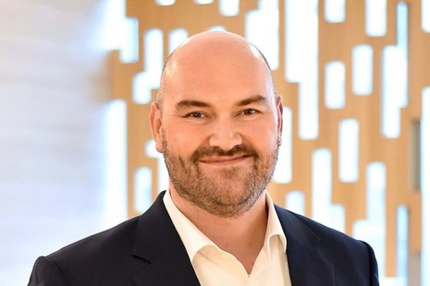
Dear Applicant,
Thank you for your interest in this post.
The School Teachers’ Review Body’s (STRB) role is to make recommendations to Ministers on matters relating to the pay and conditions of school teachers referred to it by the Secretary of State for Education.
Introduction
In recent years, we have been asked to both make annual recommendations about pay awards and to advise on reforms to pay and conditions to raise the status of the profession and support the recruitment and retention of high-quality classroom
teachers and school leaders in all schools. We receive written and oral evidence from the government and organisations representing the teacher workforce and its employers. STRB members work cooperatively to assess and, as appropriate, challenge evidence from the government and others and to develop coherent recommendations on the teachers’ pay system. We submit our reports to the Prime Minister and Secretary of State for Education. We also visit schools and local authorities to develop our understanding of issues facing teachers and school leadership teams.
The STRB’s members contribute knowledge and experience of education, labour markets, HR and pay issues, and of managing change in complex organisations. We are now looking for a new member with skills and experience which will complement that of existing members.
I do hope you are excited by the challenges this opportunity presents and that you will be inspired to apply.
Dr Mike Aldred
Chair of the STRB

Slide 4


The Review Body
The School Teachers’ Review Body (STRB) is an independent body which makes recommendations to the Prime Minister and Secretary of State for Education on the pay and conditions of school teachers in England.
The Secretary of State normally issues one remit per year for the STRB to consider. Members then assess evidence from Government and organisations representing schools and the teaching profession, and visit schools and local authorities to develop their understanding of issues facing teachers.
In addition to providing recommendations on annual pay awards for teachers and school leaders, the STRB has been asked to report on a variety of matters in recent years, including moving toward a pay structure with higher starting and early career salaries and relatively flatter pay progression and providing additional guidance to schools through advisory pay points.
The STRB’s latest 32nd report recommended an 8.9% pay uplift to teacher starting salaries outside London in 2022/23. Alongside a 5% pay award for experienced teachers and leaders in 2022/23. These recommendations were accepted in full by the Secretary of State for Education.
Recent STRB reports are available online at: School Teachers’ Review Body 32nd report: 2022 - GOV.UK (www.gov.uk)
The STRB currently has eight members, including the Chair. Collectively they have senior-level experience of education, labour market economics, HR and reward issues.
Information about current members is available at: https://www.gov.uk/government/organisations/school-teachers-review-body

Slide 5


Who We Are Looking For
All candidates will be required to demonstrate in their written application and at interview how they meet the requirements of the post.
The STRB is now seeking to fill a vacancy, to:
consider parties’ written evidence, views and proposals;
take oral evidence from parties;
assimilate information and data on pay, policy, economic, workforce and financial matters;
weigh evidence and undertake independent analysis; and
formulate conclusions and make recommendations to the Government.
The criteria that will be used to assess whether candidates have the required abilities are listed below.
Experience of providing effective leadership at a senior level within a maintained primary school or within a multi-academy trust including one or more primary schools.
Experience of managing pay and reward and a strong understanding of the related policy issues, financial management and operational constraints.
The ability to analyse and interpret a large amount of complex and sensitive information, providing insight and a working knowledge over the impact of any potential decisions on the workforce.
An ability to communicate effectively in collective decision making, assessing conflicting opinions across a wide range of perspectives and attitudes to form a coherent set of recommendations.

Slide 6

Board Diversity
The Department is focused on equality of opportunity and is committed to ensuring that public appointments better represent the views of the communities which they serve. We particularly encourage applicants from underrepresented groups, those based outside London and the South East and applicants who have achieved success through non-traditional educational routes.
The Department for Education has a strong culture of inclusion and diversity and it wants to encourage applications from people with a diverse range of backgrounds and educational routes. In 2018 we launched a five year strategy to create a department where everyone is able to bring their whole self to work and where honesty, challenge and innovation are encouraged and valued. We are recognised by leading diversity organisations for promoting diversity in the workplace.
We want to ensure any appointee to the Department’s arm’s length bodies is committed to promoting diversity, in its broadest possible sense. This will include embedding a commitment to the principles of levelling up and championing opportunity for all across the organisation, helping to ensure that the organisation is one which a genuinely diverse range of views can be expressed, without fear or favour.
CHAMPIONING SOCIAL MOBILITY
The Department champions social mobility in all of its policies and is committed to opening up opportunities for people from all backgrounds, all socio-economic classes and all regions of the UK. We are committed to embedding this principle into our recruitment and public appointments and expect all our leaders, including in arm’s length bodies, to take action to attract and retain staff from all backgrounds, while also supporting them to progress within their careers.
DISABILITY CONFIDENT
We are a member of the Government’s Disability Confident scheme and have achieved Disability Confident Leader status, signifying our role as champions of the scheme. We use the Disability Confident symbol, along with other like-minded employers, to show our commitment to good practice in employing people with a disability.
We ask that all applicants complete an anonymised Diversity Monitoring Form used for gathering data only in order to ensure departments are recruiting from the widest possible pool. The information you provide is held by the Public Appointments team and not shared with the selection panel.

Slide 7

How To Apply
The closing date for applications is Monday 19th December at 10.00am.
Information on the timetable for this campaign, selection process and the Advisory Assessment Panel can be found on the Centre for Public Appointments website: https://publicappointments.cabinetoffice.gov.uk/
Please submit the following documents by email to:
PublicAppointments.APPLICATIONS@education.gov.uk
A covering letter not exceeding two sides of A4 paper. (Arial size 12).
A CV.
Candidate application form.
Diversity form.
Please include the vacancy title in the subject box and submit each application document as a separate attachment.
We are happy to accept applications in alternative formats from applicants who, for reasons of disability, may find it difficult to fill in our standard form. If you would like to have a chat with us about reasonable adjustments please contact us at: PublicAppointments.APPLICATIONS@education.gov.uk
Please note the following:
we cannot accept applications submitted after the closing date;
applications will be assessed solely on the documentation provided; please refer to the advert and checklist above to ensure you have provided everything requested;
applications will be acknowledged upon receipt;
feedback cannot be given at application stage; it will only be given to candidates unsuccessful following interview

Slide 8
Terms Of Appointment
Location
Nationwide
Time requirement
25 days per year
Term
Up to three years
Remuneration and allowances
An attendance allowance of £300 per day for time spent in meetings and on visits. No additional fee is paid for any time spent in preparation or travelling.
Members can claim reimbursement for reasonable travel and subsistence costs incurred on STRB business at rates set centrally. The allowance and all expenses are published as part of government transparency.
Remuneration is taxable under Schedule E and subject to Class 1 National Insurance contributions. It is not pensionable. Further detail on this will be given to successful candidates.
If you receive benefits, your appointment may have an effect on your entitlement. If you are in receipt of benefits, you should seek advice from HMRC.
Appointment and tenure of office
The appointment of members will be made by the Secretary of State for Education, usually for a three-year period.
Reappointment may be made at the end of the period of office for a further term of up to three years, at the discretion of Ministers. There is no entitlement to reappointment. If reappointed, the total time served in post will not exceed six years.
It should be noted that this post is a public appointment. Therefore, such appointments are not normally subject to the provisions of employment law.
Successful candidates will be expected to start in September 2023 subject to ministerial clearance.
Pension
The post is not pensionable. (Public Appointees do not generally receive a pension as they are Office Holders, rather than employees).

Slide 9
Terms Of Appointment
Eligibility and disqualifications from appointment
Candidates who chair or are a member of another Pay Review Body may apply but would need to resign their current position on the other Review Body if appointed.
Serving teachers or headteachers may apply but can only be appointed if they resign from their post. Serving Civil Servants may also apply but can only be appointed if they resign from their Civil Service post.
There are circumstances in which an individual will not be considered for appointment.
They include:
anyone employed in a profession covered by the STRB’s remit, or whose income is affected by the STRB’s decisions (i.e. with a close family member who is affected by the STRB’s decisions);
people who have received a prison sentence or suspended sentence of 3 months or more in the last 5 years;
people who are the subject of a bankruptcy restrictions order or interim order;
people who have had an earlier term of public appointment terminated for certain reasons, for example poor performance or misconduct;
people under a disqualification order under the Company Directors Disqualification Act 1986;
people who have been removed from trusteeship of a charity;
people occupying paid party political posts; holding sensitive, senior or prominent positions in any political organisation; who are nominated for election to political office; or who are members of the House of Commons.
Further advice about disqualification for appointment can be given by contacting (PublicAppointments.DFE@education.gov.uk)
Conduct and standards in public life
Members are expected to demonstrate high standards of corporate and personal conduct and are required to adhere to the code of conduct for board members and demonstrate a sound understanding of and commitment to the principles of public life.
Training
On appointment, members will be provided with an induction led by the STRB secretariat, which is part of the Office of Manpower Economics (OME).
Security clearance
Members of the STRB are required to have or be willing to undergo security clearance (basic check and criminal record check).

Slide 10
Department for Education
© Crown copyright 2021
How to complain
Please contact the Department for Education’s Public Appointments Team if you would like to make a complaint regarding your application at:
PublicAppointments.DFE@education.gov.uk
We will acknowledge your complaint upon receipt and respond within 15 working days.
If you are not content with our response, please contact the Commissioner for Public Appointments at:
publicappointments@csc.gov.uk
Further information on complaints can be found on the Commissioner for Public Appointment’s website:
https://publicappointmentscommissioner.independent.gov.uk/

